Slide 1
Using covariates for greater precision and power in randomized trials
(A Short Course)
Ting Ye – Department of Biostatistics, University of Washington

Slide 2
Why adjusting for covariates?
Design Stage
covariate-adaptive randomization
balance across baseline covariates to gain credibility and efficiency
“Balance of treatment groups with respect to one or more specific prognostic covariates can enhance the credibility of the results of the trial” – EMA (2015) Guideline
Analysis Stage
model-assisted analysis
more efficient use of data under minimal assumption required by unadjusted analysis
“Incorporating prognostic baseline covariates in the design and analysis of clinical trial data can result in a more efficient use of data to demonstrate and quantify the effects of treatment. Moreover, this can be done with minimal impact on bias or the Type I error rate.” – FDA (2023) Guidance

Slide 3
Table of Content
Design Stage
Covariate-Adaptive Randomization
Analysis Stage
Estimand
Part I – Basic
Linear Adjustment
Nonlinear Adjustment (G-computation)
General Form of Covariate Adjustment (AIPW)
Robust Variance Estimation and Delta Method
Part II – Advanced
Covariate Adjustment in Survival Analysis
Practical Considerations

Slide 4
Table of Content
Design Stage
Covariate-Adaptive Randomization
Analysis Stage
Estimand
Part I – Basic
Linear Adjustment
Nonlinear Adjustment (G-computation)
General Form of Covariate Adjustment (AIPW)
Robust Variance Estimation and Delta Method
Part II – Advanced
Covariate Adjustment in Survival Analysis
Practical Considerations

Slide 5
Table of Content
Design Stage
Covariate-Adaptive Randomization
Analysis Stage
Estimand [15 mins with Q&A]
Part I – Basic
Linear Adjustment
Nonlinear Adjustment (G-computation)
General Form of Covariate Adjustment (AIPW)
Robust Variance Estimation and Delta Method
Part II – Advanced
Covariate Adjustment in Survival Analysis
Practical Considerations

Slide 6
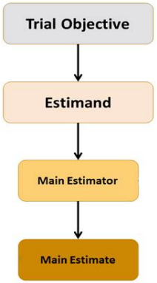
Interpretation from Estimand Framework
Target of Estimation =
WHAT to estimate
Estimand Attributes:
Treatment(s) of interest
Population of interest
Handling of relevant intercurrent events
Outcome variable (endpoint) at patient-level
Population-level summary for outcome variable
Treatment effect of interest:
Comparison between treatment(s)
E.g., difference, odds ratio, risk ratio, hazard ratio, etc.
Method of Estimation =
HOW to estimate
Covariate adjustment (at analysis stage) is a method of estimation
consists of a covariate adjusted estimator and its corresponding standard error under minimal conditions
lead to more efficient use of the data (narrower confidence intervals and more powerful hypothesis testing)
However, improper covariate adjustment can change the definition of the treatment effect that is being estimated.
Covariate Adjustment should ONLY affect how to estimate, but NOT what to estimate.

Slide 7
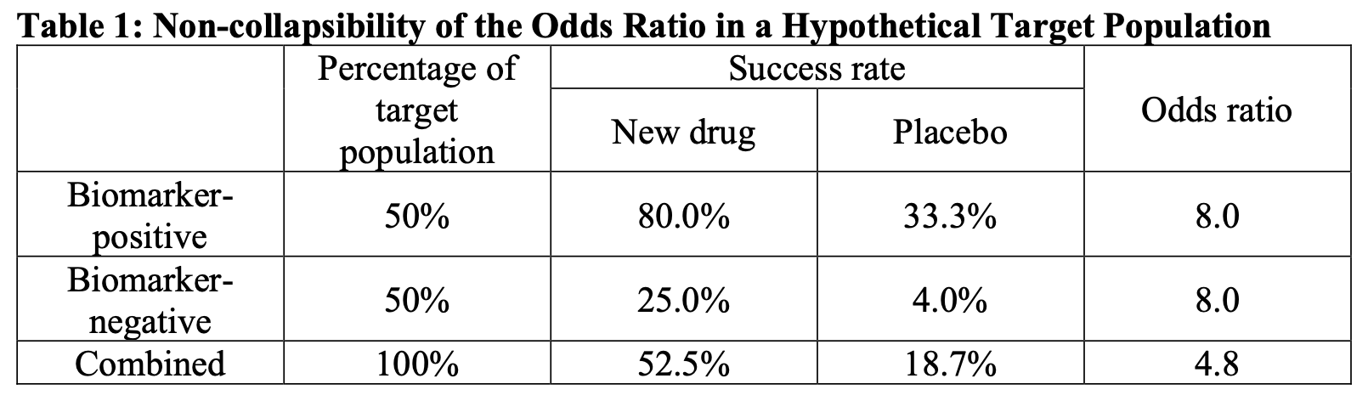
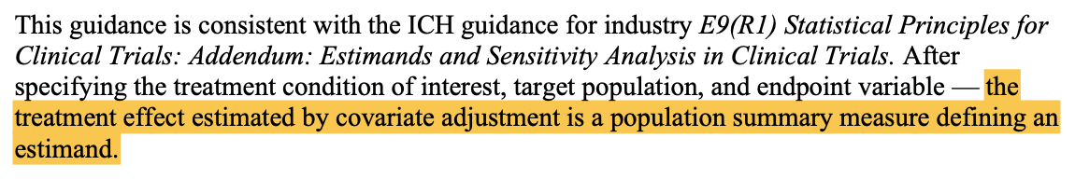
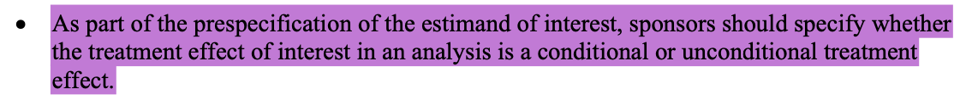
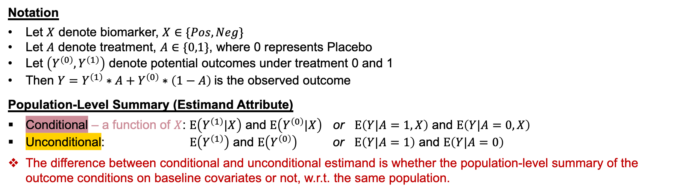
Review
Covariate Adjustment shall tailor to Estimand
(Constant) Conditional Odds Ratio
Unconditional Odds Ratio
Coefficient of Logistic regression is estimating the value of 8.0
* Page 6 of FDA final guidance for covariate adjustment.
G-computation using Logistic regression is estimating the unconditional mean of each treatment group, providing the basis for estimating the value of 4.8
Notation
Let $X$ denote biomarker, $X∈\{Pos,Neg\}$
Let $A$ denote treatment, $A∈\{0,1\}$, where 0 represents Placebo
Let $\left(Y^{\left(0\right)}, Y^{\left(1\right)}\right)$ denote potential outcomes under treatment 0 and 1
Then $Y=Y^{\left(1\right)}∗A+Y^{\left(0\right)}∗\left(1−A\right)$is the observed outcome
Population-Level Summary (Estimand Attribute)
Conditional – a function of $X$: $E\left(Y^{\left(1\right)}|X\right)$ and $E\left(Y^{\left(0\right)}|X\right)$ or $E\left(Y|A=1, X\right)$ and $E\left(Y|A=0,X\right)$
Unconditional: $E\left(Y^{\left(1\right)}\right)$ and $E\left(Y^{\left(0\right)}\right)$ or $E\left(Y|A=1\right)$ and $E\left(Y|A=0\right)$
The difference between conditional and unconditional estimand is whether the population-level summary of the outcome conditions on baseline covariates or not, w.r.t. the same population.
Notes:
Add one more slide to quote FDA guidance on prespecify estimand.

Slide 8


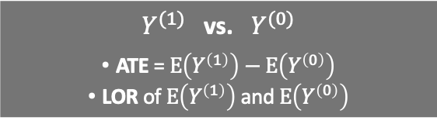
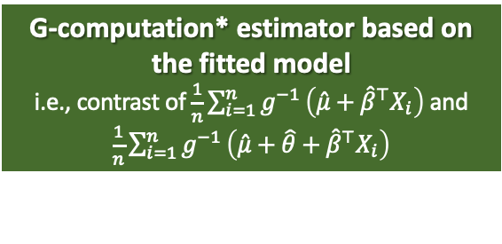
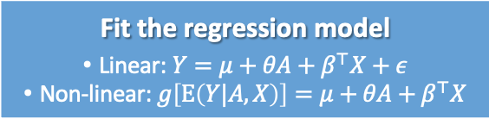
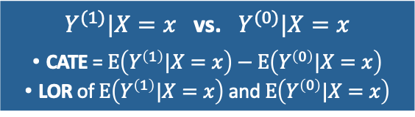




Review
Covariate Adjustment shall tailor to Estimand
Estimand
Conditional Treatment Effect
Unconditional Treatment Effect
Unconditional Treatment Effect
$Y^{(1)}|X=x$ vs. $Y^{(0)}|X=x$
CATE = $E\left(Y^{\left(1\right)}|X=x\right)−E\left(Y^{\left(0\right)}|X=x\right)$
LOR of $E\left(Y^{\left(1\right)}|X=x\right)$ and $E\left(Y^{\left(0\right)}|X=x\right)$
$Y^{(1)}$ vs. $Y^{(0)}$
ATE = $E\left(Y^{\left(1\right)}\right)−E\left(Y^{\left(0\right)}\right)$
LOR of $E\left(Y^{\left(1\right)}\right)$ and $E\left(Y^{\left(0\right)}\right)$
$Y^{(1)}$ vs. $Y^{(0)}$
ATE = $E\left(Y^{\left(1\right)}\right)−E\left(Y^{\left(0\right)}\right)$
LOR of $E\left(Y^{\left(1\right)}\right)$ and $E\left(Y^{\left(0\right)}\right)$
Assumption
Assume regression model is TRUE
NO model assumption
NO model assumption
Estimation
Fit the regression model
Linear: $Y=μ+θA+β^{⊤}X+ε$
Non-linear: $g\left[E\left(Y|A,X\right)\right]=μ+θA+β^{⊤}X$
Obtain sample mean of each group,
or fit regression with treatment only
$$\overline{Y_{0}},\overline{Y_{1}}$$
Fit the regression model
Linear: $Y=μ+θA+β^{⊤}X+ε$
Non-linear: $g\left[E\left(Y|A,X\right)\right]=μ+θA+β^{⊤}X$
$\hat{θ}$ estimated from the model
G-computation* estimator based on the fitted model
i.e., contrast of $\frac{1}{n}\sum_{i=1}^{n}{g^{−1}}\left(\hat{μ}+{\hat{β}}^{⊤}X_{i}\right)$ and $\frac{1}{n}\sum_{i=1}^{n}{g^{−1}}\left(\hat{μ}+\hat{θ}+{\hat{β}}^{⊤}X_{i}\right)$
Contrast of $\overline{Y_{0}}$ and $\overline{Y_{1}}$
Adjusted Analysis
Unadjusted Analysis
Adjusted Analysis
Adjusted Analysis
for conditional treatment effect
Adjusted Analysis
for unconditional treatment effect
* WARNING: G-computation requires canonical link GLM. AIPW is the general form.

Slide 9
Review
Short Course Topic
Covariate Adjustment for Unconditional Treatment Effect
Covariate Adjustment shall tailor to Estimand
Estimand
Conditional Treatment Effect
Unconditional Treatment Effect
$Y^{(1)}|X=x$ vs. $Y^{(0)}|X=x$
CATE = $E\left(Y^{\left(1\right)}|X=x\right)−E\left(Y^{\left(0\right)}|X=x\right)$
LOR of $E\left(Y^{\left(1\right)}|X=x\right)$ and $E\left(Y^{\left(0\right)}|X=x\right)$
$Y^{(1)}$ vs. $Y^{(0)}$
ATE = $E\left(Y^{\left(1\right)}\right)−E\left(Y^{\left(0\right)}\right)$
LOR of $E\left(Y^{\left(1\right)}\right)$ and $E\left(Y^{\left(0\right)}\right)$
Assumption
Assume regression model is TRUE
NO model assumption
Estimation
Fit the regression model
Linear: $Y=μ+θA+β^{⊤}X+ε$
Non-linear: $g\left[E\left(Y|A,X\right)\right]=μ+θA+β^{⊤}X$
Obtain sample mean of each group,
or fit regression with treatment only
$$\overline{Y_{0}},\overline{Y_{1}}$$
$\hat{θ}$ estimated from the model
G-computation* estimator based on the fitted model
i.e., contrast of $\frac{1}{n}\sum_{i=1}^{n}{g^{−1}}\left(\hat{μ}+{\hat{β}}^{⊤}X_{i}\right)$ and $\frac{1}{n}\sum_{i=1}^{n}{g^{−1}}\left(\hat{μ}+\hat{θ}+{\hat{β}}^{⊤}X_{i}\right)$
Contrast of $\overline{Y_{0}}$ and $\overline{Y_{1}}$
Adjusted Analysis
Unadjusted Analysis
Adjusted Analysis
for conditional treatment effect
Adjusted Analysis
for unconditional treatment effect
* WARNING: G-computation requires canonical link GLM. AIPW is the general form.

Slide 10
Table of Content
Design Stage
Covariate-Adaptive Randomization
Analysis Stage
Estimand
Part I – Basic
Linear Adjustment [45 mins with practice + 15 mins break]
Nonlinear Adjustment (G-computation) [20 mins with practice]
General Form of Covariate Adjustment (AIPW) [40 mins with practice + 15 mins break]
Robust Variance Estimation and Delta method [60 mins with practice]
Part II – Advanced
Advanced Theories and Strategies
Covariate Adjustment in Survival Analysis
Practical Considerations

Slide 11
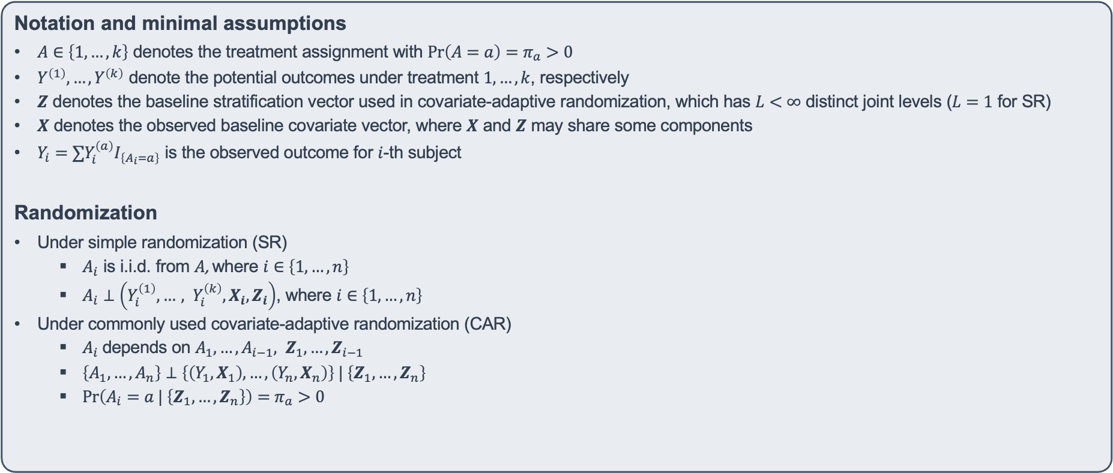
Covariate Adjustment for Unconditional Treatment Effect
Estimand: any comparison of $E\left(Y^{\left(1\right)}\right),E\left(Y^{\left(2\right)}\right),…,E\left(Y^{\left(k\right)}\right)$
Notation and minimal assumptions
$A∈\left\{1, …, k\right\}$ denotes the treatment assignment with $Pr\left(A=a\right)=π_{a}>0$
$Y^{\left(1\right)}, …, Y^{\left(k\right)}$ denote the potential outcomes under treatment $1, …, k$, respectively
$Z$ denotes the baseline stratification vector used in covariate-adaptive randomization, which has $L<∞$ distinct joint levels ($L=1$ for SR)
$X$ denotes the observed baseline covariate vector, where $X$ and $Z$ may share some components
$Y_{i}=∑Y_{i}^{\left(a\right)}I_{\left\{A_{i}=a\right\}}$ is the observed outcome for $i$-th subject
Randomization
Under simple randomization (SR)
$A_{i}$ is i.i.d. from $A$, where $i∈\left\{1,…,n\right\}$
$A_{i}⊥\left(Y_{i}^{\left(1\right)}, …, Y_{i}^{\left(k\right)}, X_{i}, Z_{i}\right)$, where $i∈\left\{1,…,n\right\}$
Under commonly used covariate-adaptive randomization (CAR)
$A_{i}$ depends on $A_{1},…,A_{i−1}, Z_{1},…,Z_{i−1}$
$\left\{A_{1},…,A_{n}\right\}⊥\left\{\left(Y_{1},X_{1}\right),…,\left(Y_{n},X_{n}\right)\right\} | \left\{Z_{1},…,Z_{n}\right\}$
$Pr\left(A_{i}=a | \left\{Z_{1},…,Z_{n}\right\}\right)=π_{a}>0$

Slide 12
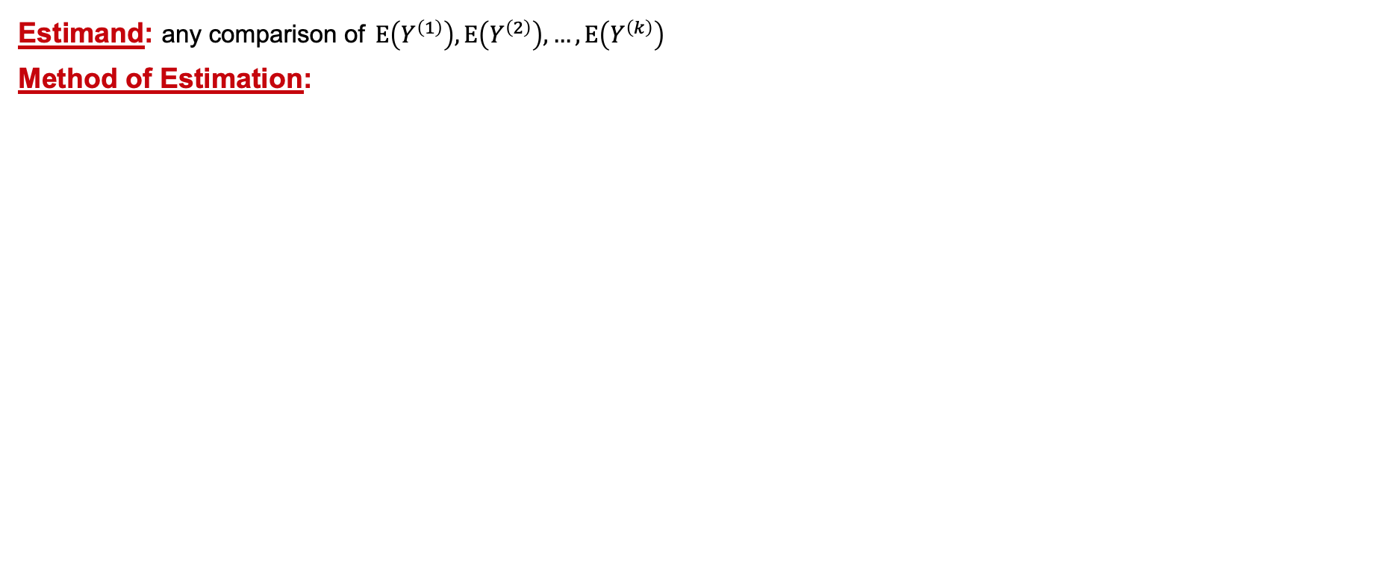
Covariate Adjustment for Unconditional Treatment Effect
Estimand: any comparison of $E\left(Y^{\left(1\right)}\right),E\left(Y^{\left(2\right)}\right),…,E\left(Y^{\left(k\right)}\right)$
Method of Estimation:
 | Working Model | Estimator ${\left({\hat{θ}}_{1},…,{\hat{θ}}_{k}\right)}^{⊤}$ | R function
Unadjusted | $E\left(Y | A\right)=∑γ_{a}I_{\left\{A=a\right\}}$ | ${\hat{γ}}_{a}$, $a=1,…,k$ | robincar_linear

Slide 13
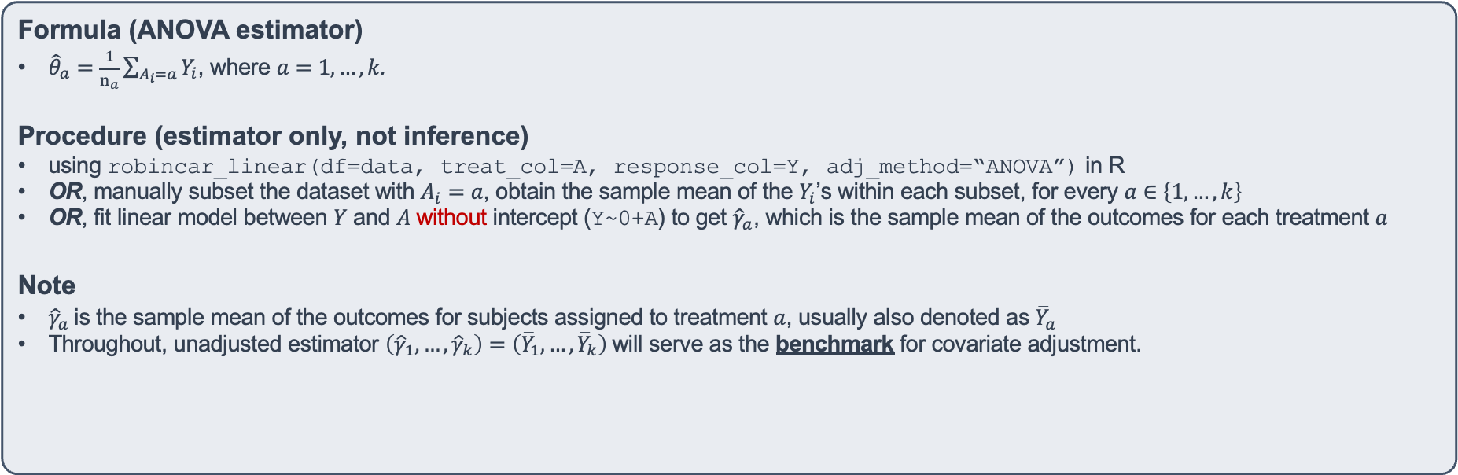
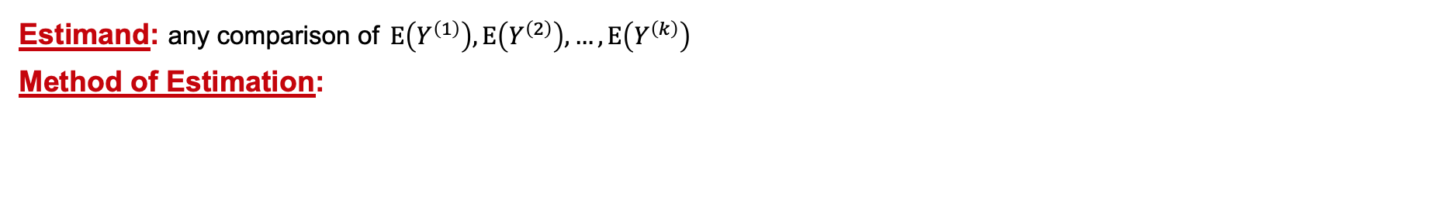
Unadjusted Estimator for Unconditional Treatment Effect
Estimand: any comparison of $E\left(Y^{\left(1\right)}\right),E\left(Y^{\left(2\right)}\right),…,E\left(Y^{\left(k\right)}\right)$
Method of Estimation:
 | Working Model | Estimator ${\left({\hat{θ}}_{1},…,{\hat{θ}}_{k}\right)}^{⊤}$ | R function
Unadjusted | $E\left(Y | A\right)=∑γ_{a}I_{\left\{A=a\right\}}$ | ${\hat{γ}}_{a}$, $a=1,…,k$ | robincar_linear
Formula (ANOVA estimator)
${\hat{θ}}_{a}=\frac{1}{n_{a}}\sum_{A_{i}=a}{Y_{i}}$, where $a=1,…,k$.
Procedure (estimator only, not inference)
using robincar_linear(df=data, treat_col=A, response_col=Y, adj_method=“ANOVA”) in R
OR, manually subset the dataset with $A_{i}=a$, obtain the sample mean of the $Y_{i}$’s within each subset, for every $a∈\left\{1,…,k\right\}$
OR, fit linear model between $Y$ and $A$ without intercept (Y~0+A) to get ${\hat{γ}}_{a}$, which is the sample mean of the outcomes for each treatment $a$
Note
${\hat{γ}}_{a}$ is the sample mean of the outcomes for subjects assigned to treatment $a$, usually also denoted as ${\overline{Y}}_{a}$
Throughout, unadjusted estimator $\left({\hat{γ}}_{1},…,{\hat{γ}}_{k}\right)=\left({\overline{Y}}_{1},…,{\overline{Y}}_{k}\right)$ will serve as the benchmark for covariate adjustment.

Slide 14
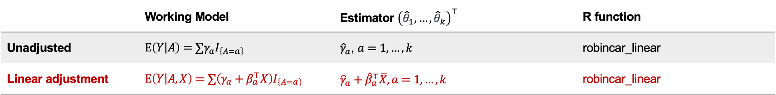
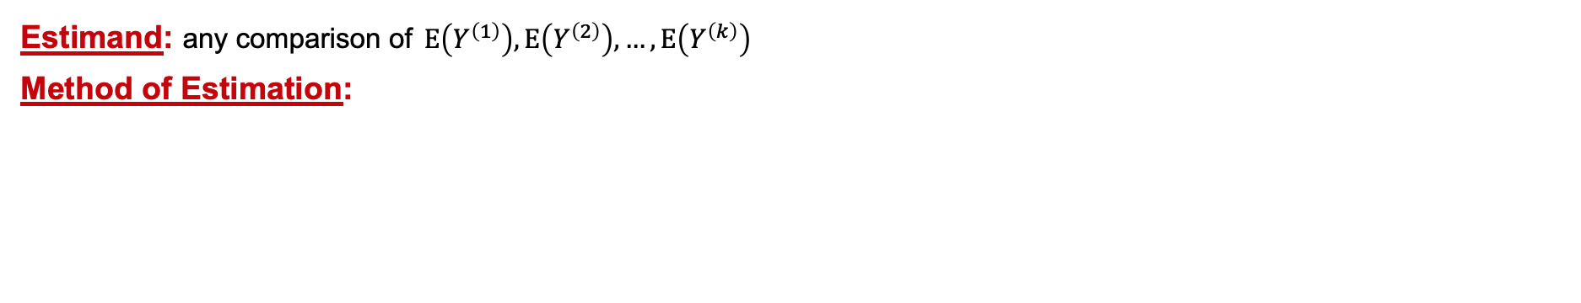
Covariate Adjustment for Unconditional Treatment Effect
Estimand: any comparison of $E\left(Y^{\left(1\right)}\right),E\left(Y^{\left(2\right)}\right),…,E\left(Y^{\left(k\right)}\right)$
Method of Estimation:
 | Working Model | Estimator ${\left({\hat{θ}}_{1},…,{\hat{θ}}_{k}\right)}^{⊤}$ | R function
Unadjusted | $E\left(Y | A\right)=∑γ_{a}I_{\left\{A=a\right\}}$ | ${\hat{γ}}_{a}$, $a=1,…,k$ | robincar_linear
Linear adjustment | $E\left(Y | A, X\right)=∑\left(γ_{a}+β_{a}^{⊤}X\right)I_{\left\{A=a\right\}}$ | $${\hat{γ}}_{a}+{\hat{β}}_{a}^{⊤}\overline{X}, a=1,…,k$$ | robincar_linear
Unadjusted estimator is a special case of linearly adjusted estimator, by setting $β_{1}=…=β_{k}=0$

Slide 15
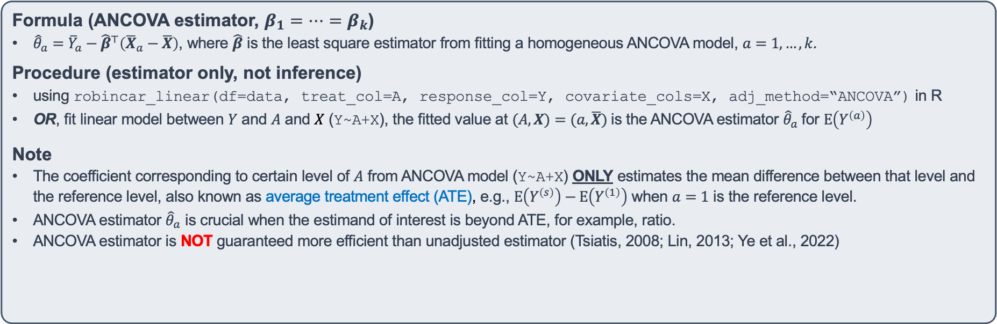
Linear Adjustment for Unconditional Treatment Effect
Estimand: any comparison of $E\left(Y^{\left(1\right)}\right),E\left(Y^{\left(2\right)}\right),…,E\left(Y^{\left(k\right)}\right)$
Method of Estimation:
 | Working Model | Estimator ${\left({\hat{θ}}_{1},…,{\hat{θ}}_{k}\right)}^{⊤}$ | R function
Linear adjustment | $E\left(Y | A, X\right)=∑\left(γ_{a}+β_{a}^{⊤}X\right)I_{\left\{A=a\right\}}$ | $${\hat{γ}}_{a}+{\hat{β}}_{a}^{⊤}\overline{X}, a=1,…,k$$ | robincar_linear
Formula (ANCOVA estimator, $β_{1}=…=β_{k}$)
${\hat{θ}}_{a}={\overline{Y}}_{a}−{\hat{β}}^{⊤}\left({\overline{X}}_{a}−\overline{X}\right)$, where $\hat{β}$ is the least square estimator from fitting a homogeneous ANCOVA model, $a=1,…,k$.
Procedure (estimator only, not inference)
using robincar_linear(df=data, treat_col=A, response_col=Y, covariate_cols=X, adj_method=“ANCOVA”) in R
OR, fit linear model between $Y$ and $A$ and $X$ (Y~A+X), the fitted value at $(A,X)=(a, \overline{X})$ is the ANCOVA estimator ${\hat{θ}}_{a}$ for $E\left(Y^{\left(a\right)}\right)$
Note
The coefficient corresponding to certain level of $A$ from ANCOVA model (Y~A+X) ONLY estimates the mean difference between that level and the reference level, also known as average treatment effect (ATE), e.g., $E\left(Y^{\left(s\right)}\right)−E\left(Y^{\left(1\right)}\right)$ when $a=1$ is the reference level.
ANCOVA estimator ${\hat{θ}}_{a}$ is crucial when the estimand of interest is beyond ATE, for example, ratio.
ANCOVA estimator is NOT guaranteed more efficient than unadjusted estimator (Tsiatis, 2008; Lin, 2013; Ye et al., 2022)

Slide 16
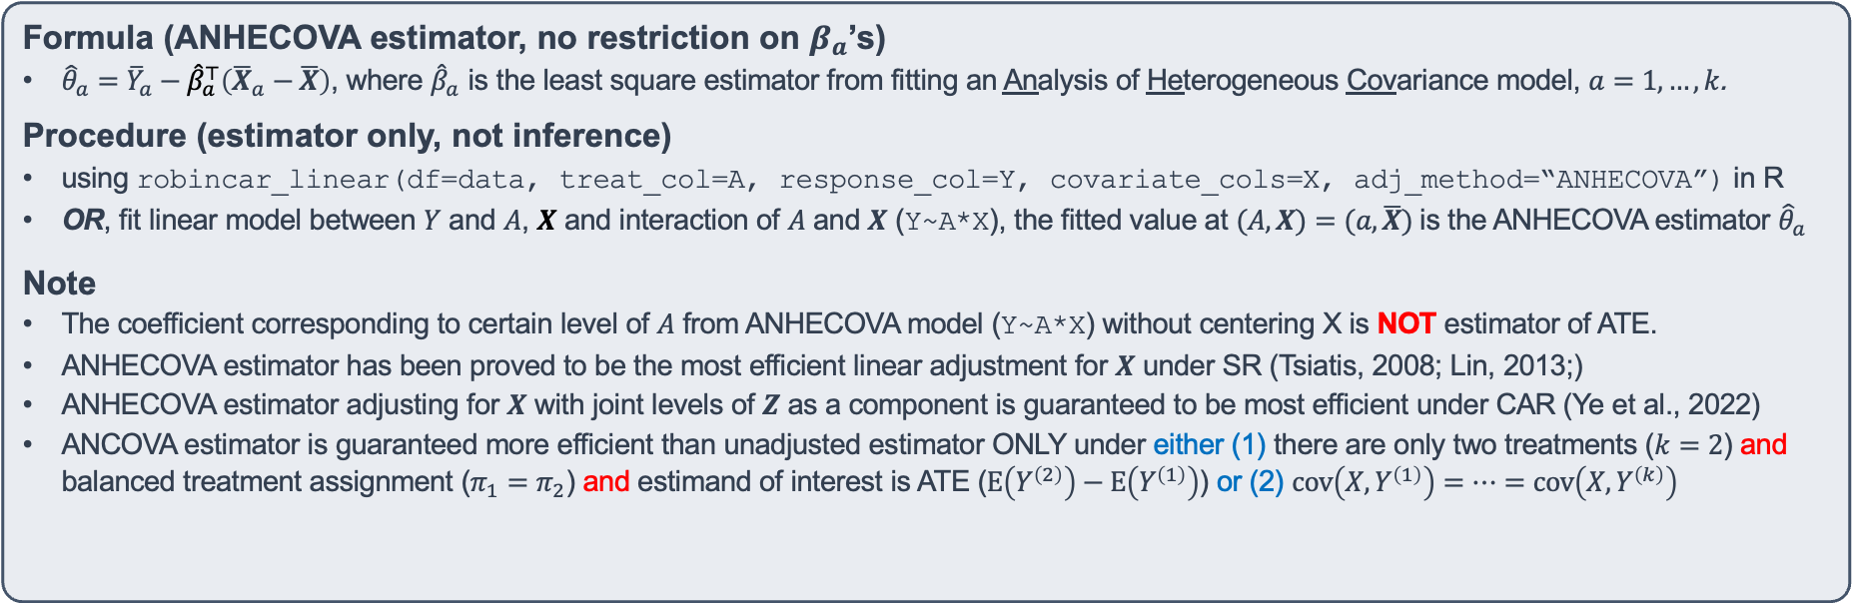
Linear Adjustment for Unconditional Treatment Effect
Estimand: any comparison of $E\left(Y^{\left(1\right)}\right),E\left(Y^{\left(2\right)}\right),…,E\left(Y^{\left(k\right)}\right)$
Method of Estimation:
 | Working Model | Estimator ${\left({\hat{θ}}_{1},…,{\hat{θ}}_{k}\right)}^{⊤}$ | R function
Linear adjustment | $E\left(Y | A, X\right)=∑\left(γ_{a}+β_{a}^{⊤}X\right)I_{\left\{A=a\right\}}$ | $${\hat{γ}}_{a}+{\hat{β}}_{a}^{⊤}\overline{X}, a=1,…,k$$ | robincar_linear
Formula (ANHECOVA estimator, no restriction on $β_{a}$’s)
${\hat{θ}}_{a}={\overline{Y}}_{a}−{\hat{β}}_{a}^{⊤}\left({\overline{X}}_{a}−\overline{X}\right)$, where ${\hat{β}}_{a}$ is the least square estimator from fitting an Analysis of Heterogeneous Covariance model, $a=1,…,k$.
Procedure (estimator only, not inference)
using robincar_linear(df=data, treat_col=A, response_col=Y, covariate_cols=X, adj_method=“ANHECOVA”) in R
OR, fit linear model between $Y$ and $A$, $X$ and interaction of $A$ and $X$ (Y~A*X), the fitted value at $(A,X)=(a, \overline{X})$ is the ANHECOVA estimator ${\hat{θ}}_{a}$
Note
The coefficient corresponding to certain level of $A$ from ANHECOVA model (Y~A*X) without centering X is NOT estimator of ATE.
ANHECOVA estimator has been proved to be the most efficient linear adjustment for $X$ under SR (Tsiatis, 2008; Lin, 2013;)
ANHECOVA estimator adjusting for $X$ with joint levels of $Z$ as a component is guaranteed to be most efficient under CAR (Ye et al., 2022)
ANCOVA estimator is guaranteed more efficient than unadjusted estimator ONLY under either (1) there are only two treatments ($k=2$) and balanced treatment assignment ($π_{1}=π_{2}$) and estimand of interest is ATE ($E\left(Y^{\left(2\right)}\right)−E\left(Y^{\left(1\right)}\right)$) or (2) $cov\left(X, Y^{\left(1\right)}\right)=…=cov\left(X, Y^{\left(k\right)}\right)$

Slide 17
Linear Adjustment for Unconditional Treatment Effect
Estimand: any comparison of $E\left(Y^{\left(1\right)}\right),E\left(Y^{\left(2\right)}\right),…,E\left(Y^{\left(k\right)}\right)$
Method of Estimation:
 | Working Model | Estimator ${\left({\hat{θ}}_{1},…,{\hat{θ}}_{k}\right)}^{⊤}$ | R function
Linear adjustment | $E\left(Y | A, X\right)=∑\left(γ_{a}+β_{a}^{⊤}X\right)I_{\left\{A=a\right\}}$ | $${\hat{γ}}_{a}+{\hat{β}}_{a}^{⊤}\overline{X}, a=1,…,k$$ | robincar_linear
Practice 1 – Part I (details in Practice1.Rmd)
Use Fun_datagen(Fun.n = 500, Fun.y.type = ”continuous", Fun.rand = "SR", Fun.p = 2/3) to generate a simulated data
Use robincar_linear to obtain unadjusted, ANCOVA and ANHECOVA estimator under SR
Generate 1000 simulated datasets with continuous outcome, get estimates using unadjusted, ANCOVA and ANHECOVA estimator, and summarize bias and SD for all estimates.
(After-class exercise) Code your own R function for unadjusted estimator, ANCOVA, and ANHECOVA.

Slide 18
Table of Content
Design Stage
Covariate-Adaptive Randomization
Analysis Stage
Estimand
Part I – Basic
Linear Adjustment [45 mins with practice + 15 mins break]
Nonlinear Adjustment (G-computation) [20 mins with practice]
General Form of Covariate Adjustment (AIPW) [40 mins with practice + 15 mins break]
Robust Variance Estimation and Delta method [60 mins with practice]
Part II – Advanced
Covariate Adjustment in Survival Analysis
Practical Considerations

Slide 19
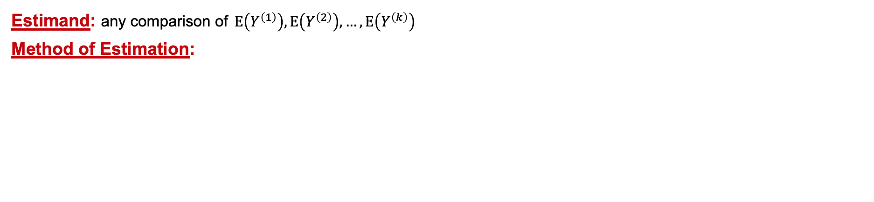
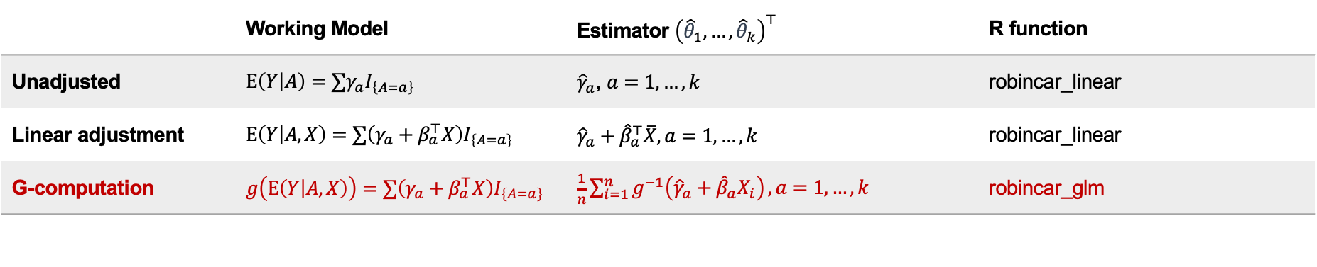
Covariate Adjustment for Unconditional Treatment Effect
Estimand: any comparison of $E\left(Y^{\left(1\right)}\right),E\left(Y^{\left(2\right)}\right),…,E\left(Y^{\left(k\right)}\right)$
Method of Estimation:
 | Working Model | Estimator ${\left({\hat{θ}}_{1},…,{\hat{θ}}_{k}\right)}^{⊤}$ | R function
Unadjusted | $E\left(Y | A\right)=∑γ_{a}I_{\left\{A=a\right\}}$ | ${\hat{γ}}_{a}$, $a=1,…,k$ | robincar_linear
Linear adjustment | $E\left(Y | A, X\right)=∑\left(γ_{a}+β_{a}^{⊤}X\right)I_{\left\{A=a\right\}}$ | $${\hat{γ}}_{a}+{\hat{β}}_{a}^{⊤}\overline{X}, a=1,…,k$$ | robincar_linear
G-computation | $g\left(E\left(Y | A, X\right)\right)=∑\left(γ_{a}+β_{a}^{⊤}X\right)I_{\left\{A=a\right\}}$ | $\frac{1}{n}\sum_{i=1}^{n}{g^{−1}\left({\hat{γ}}_{a}+{\hat{β}}_{a}X_{i}\right)}, a=1,…,k$ | robincar_glm
Unadjusted estimator is a special case of linearly adjusted estimator, by setting $β_{1}=…=β_{k}=0$
Linear adjustment is a special case of G-computation, by setting link function as identity function $g(x)=x$
Notes:
Robust variance

Slide 20

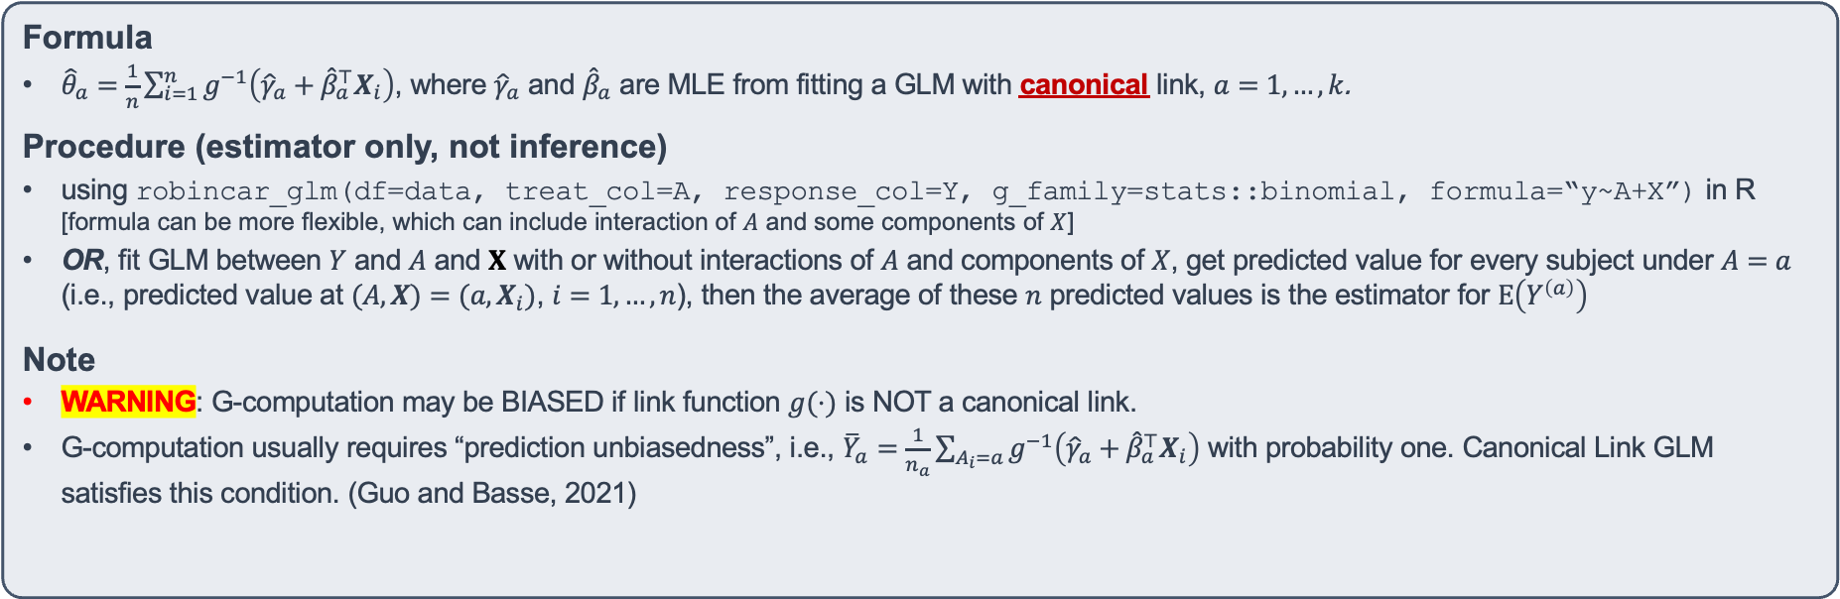
G-computation for Unconditional Treatment Effect
Estimand: any comparison of $E\left(Y^{\left(1\right)}\right),E\left(Y^{\left(2\right)}\right),…,E\left(Y^{\left(k\right)}\right)$
Method of Estimation:
 | Working Model | Estimator ${\left({\hat{θ}}_{1},…,{\hat{θ}}_{k}\right)}^{⊤}$ | R function
G-computation | $g\left(E\left(Y | A, X\right)\right)=∑\left(γ_{a}+β_{a}^{⊤}X\right)I_{\left\{A=a\right\}}$ | $\frac{1}{n}\sum_{i=1}^{n}{g^{−1}\left({\hat{γ}}_{a}+{\hat{β}}_{a}^{⊤}X_{i}\right)}, a=1,…,k$ | robincar_glm
Formula
${\hat{θ}}_{a}=\frac{1}{n}\sum_{i=1}^{n}{g^{−1}\left({\hat{γ}}_{a}+{\hat{β}}_{a}^{⊤}X_{i}\right)}$, where ${\hat{γ}}_{a}$ and ${\hat{β}}_{a}$ are MLE from fitting a GLM with canonical link, $a=1,…,k$.
Procedure (estimator only, not inference)
using robincar_glm(df=data, treat_col=A, response_col=Y, g_family=stats::binomial, formula=“y~A+X”) in R [formula can be more flexible, which can include interaction of $A$ and some components of $X$]
OR, fit GLM between $Y$ and $A$ and $X$ with or without interactions of $A$ and components of $X$, get predicted value for every subject under $A=a$ (i.e., predicted value at $(A,X)=(a, X_{i})$, $i=1,…,n$), then the average of these $n$ predicted values is the estimator for $E\left(Y^{\left(a\right)}\right)$
Note
WARNING: G-computation may be BIASED if link function $g(⋅)$ is NOT a canonical link.
G-computation usually requires “prediction unbiasedness”, i.e., ${\overline{Y}}_{a}=\frac{1}{n_{a}}\sum_{A_{i}=a}{g^{−1}\left({\hat{γ}}_{a}+{\hat{β}}_{a}^{⊤}X_{i}\right)}$ with probability one. Canonical Link GLM satisfies this condition. (Guo and Basse, 2021)

Slide 21
G-computation for Unconditional Treatment Effect
Estimand: any comparison of $E\left(Y^{\left(1\right)}\right),E\left(Y^{\left(2\right)}\right),…,E\left(Y^{\left(k\right)}\right)$
Method of Estimation:
 | Working Model | Estimator ${\left({\hat{θ}}_{1},…,{\hat{θ}}_{k}\right)}^{⊤}$ | R function
G-computation | $g\left(E\left(Y | A, X\right)\right)=∑\left(γ_{a}+β_{a}^{⊤}X\right)I_{\left\{A=a\right\}}$ | $\frac{1}{n}\sum_{i=1}^{n}{g^{−1}\left({\hat{γ}}_{a}+{\hat{β}}_{a}^{⊤}X_{i}\right)}, a=1,…,k$ | robincar_glm
Practice 1 – Part II (details in Practice1.Rmd)
Use Fun_datagen(Fun.n=500, Fun.y.type=”binary", Fun.rand="SR", Fun.p=2/3) to generate data with binary outcome
Read a hand-coded R function for G-computation (named Fun_gcomp)
Generate 1000 simulated datasets with count outcome, in the meantime get the true mean of the outcome under each treatment
Get estimates using Fun_gcomp supplied with Poisson regression using glm(family = Poisson)
Get estimates using Fun_gcomp supplied with Negative Binomial regression using MASS::glm.nb
Summarize bias and SD for all estimates

Slide 22

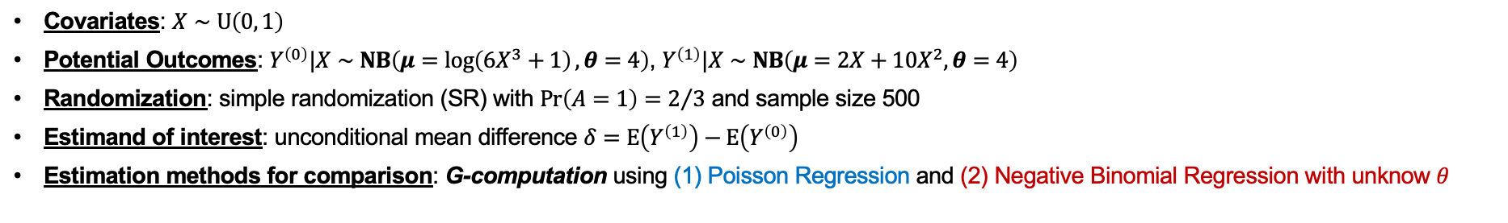
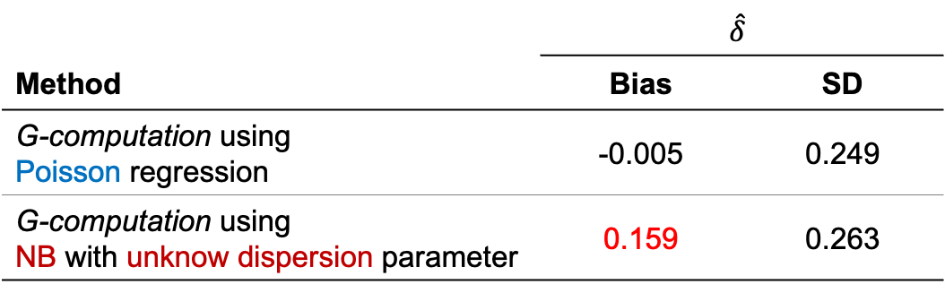
Simulation (G-computation can be biased)
Covariates: $X∼U\left(0, 1\right)$
Potential Outcomes: $Y^{\left(0\right)}|X∼NB\left(μ=\log\left(6X^{3}+1\right), θ=4\right)$, $Y^{\left(1\right)}|X∼NB\left(μ=2X+10X^{2}, θ=4\right)$
Randomization: simple randomization (SR) with $Pr\left(A=1\right)=2/3$ and sample size 500
Estimand of interest: unconditional mean difference $δ=E\left(Y^{\left(1\right)}\right)−E\left(Y^{\left(0\right)}\right)$
Estimation methods for comparison: G-computation using (1) Poisson Regression and (2) Negative Binomial Regression with unknow $θ$
 | $$\hat{δ}$$
Method | Bias | SD
G-computation using Poisson regression | -0.005 | 0.249
G-computation using NB with unknow dispersion parameter | 0.159 | 0.263
Poisson regression uses “log” link, a canonical link, hence, G-computation is unbiased
Negative Binomial regression with unknown dispersion parameter (estimated by maximum likelihood) is NOT a GLM with canonical link, hence, G-computation is biased.
Notes:
A gamma mixture of Poisson = rnegbin(mu, theta) = f(k; r=theta, p=theta/(mu+theta)) = k failures needed (kth failure) given r successes → modeling count data as failures (K) → E(k)=mu=r(1-p)/p and Var(k)=mu+mu^2/theta=r(1-p)/p^2
rnbinom(r, p) in R is generating n=r+k, which is the total independent Bernoulli trials that are needed to achieve r successes. E(n)=E(k) + r =

Slide 23
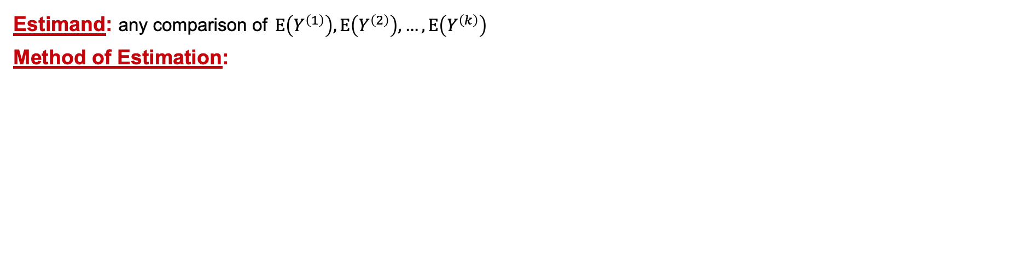
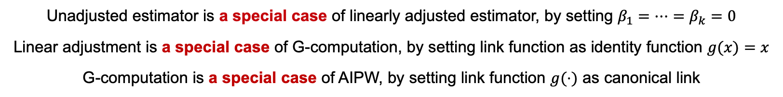
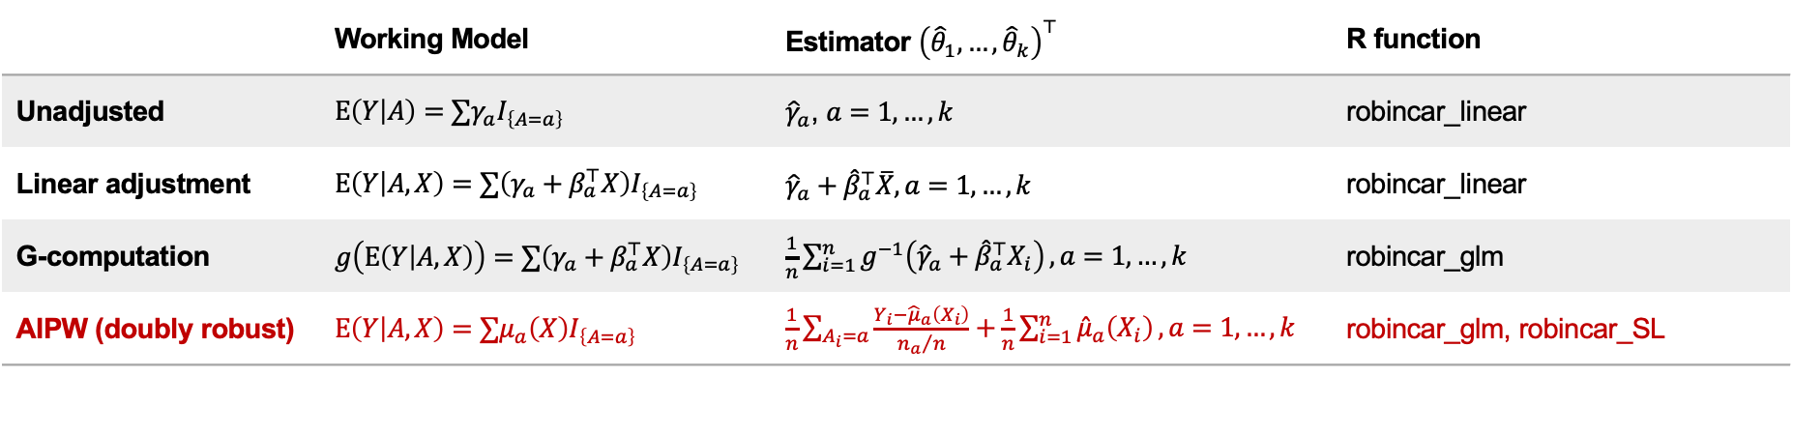
Covariate Adjustment for Unconditional Treatment Effect
Estimand: any comparison of $E\left(Y^{\left(1\right)}\right),E\left(Y^{\left(2\right)}\right),…,E\left(Y^{\left(k\right)}\right)$
Method of Estimation:
 | Working Model | Estimator ${\left({\hat{θ}}_{1},…,{\hat{θ}}_{k}\right)}^{⊤}$ | R function
Unadjusted | $E\left(Y | A\right)=∑γ_{a}I_{\left\{A=a\right\}}$ | ${\hat{γ}}_{a}$, $a=1,…,k$ | robincar_linear
Linear adjustment | $E\left(Y | A, X\right)=∑\left(γ_{a}+β_{a}^{⊤}X\right)I_{\left\{A=a\right\}}$ | $${\hat{γ}}_{a}+{\hat{β}}_{a}^{⊤}\overline{X}, a=1,…,k$$ | robincar_linear
G-computation | $g\left(E\left(Y | A, X\right)\right)=∑\left(γ_{a}+β_{a}^{⊤}X\right)I_{\left\{A=a\right\}}$ | $\frac{1}{n}\sum_{i=1}^{n}{g^{−1}\left({\hat{γ}}_{a}+{\hat{β}}_{a}^{⊤}X_{i}\right)}, a=1,…,k$ | robincar_glm
AIPW (doubly robust) | $E\left(Y | A, X\right)=∑μ_{a}\left(X\right)I_{\left\{A=a\right\}}$ | $\frac{1}{n}\sum_{A_{i}=a}{\frac{Y_{i}−{\hat{μ}}_{a}\left(X_{i}\right)}{{n_{a}}/n}}+\frac{1}{n}\sum_{i=1}^{n}{{\hat{μ}}_{a}\left(X_{i}\right)}, a=1,…,k$ | robincar_glm, robincar_SL
Unadjusted estimator is a special case of linearly adjusted estimator, by setting $β_{1}=…=β_{k}=0$
Linear adjustment is a special case of G-computation, by setting link function as identity function $g(x)=x$
G-computation is a special case of AIPW, by setting link function $g(⋅)$ as canonical link
Notes:
Robust variance

Slide 24
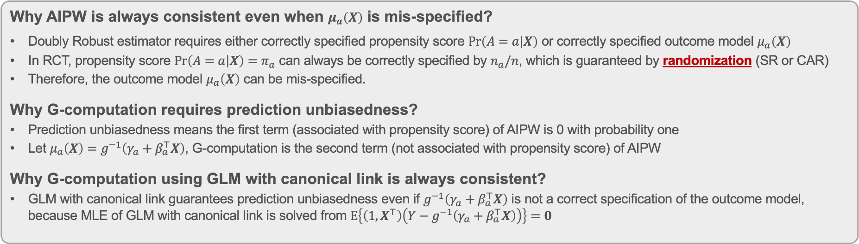
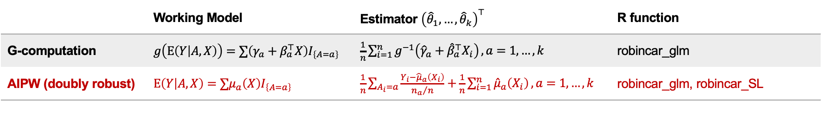
G-computation is a special case of AIPW
Estimand: any comparison of $E\left(Y^{\left(1\right)}\right),E\left(Y^{\left(2\right)}\right),…,E\left(Y^{\left(k\right)}\right)$
Method of Estimation:
 | Working Model | Estimator ${\left({\hat{θ}}_{1},…,{\hat{θ}}_{k}\right)}^{⊤}$ | R function
G-computation | $g\left(E\left(Y | A, X\right)\right)=∑\left(γ_{a}+β_{a}^{⊤}X\right)I_{\left\{A=a\right\}}$ | $\frac{1}{n}\sum_{i=1}^{n}{g^{−1}\left({\hat{γ}}_{a}+{\hat{β}}_{a}^{⊤}X_{i}\right)}, a=1,…,k$ | robincar_glm
AIPW (doubly robust) | $E\left(Y | A, X\right)=∑μ_{a}\left(X\right)I_{\left\{A=a\right\}}$ | $\frac{1}{n}\sum_{A_{i}=a}{\frac{Y_{i}−{\hat{μ}}_{a}\left(X_{i}\right)}{{n_{a}}/n}}+\frac{1}{n}\sum_{i=1}^{n}{{\hat{μ}}_{a}\left(X_{i}\right)}, a=1,…,k$ | robincar_glm, robincar_SL
Why AIPW is always consistent even when $μ_{a}\left(X\right)$ is mis-specified?
Doubly Robust estimator requires either correctly specified propensity score $Pr\left(A=a | X\right)$ or correctly specified outcome model $μ_{a}\left(X\right)$
In RCT, propensity score $Pr\left(A=a | X\right)=π_{a}$ can always be correctly specified by $n_{a}/n$, which is guaranteed by randomization (SR or CAR)
Therefore, the outcome model $μ_{a}\left(X\right)$ can be mis-specified.
Why G-computation requires prediction unbiasedness?
Prediction unbiasedness means the first term (associated with propensity score) of AIPW is 0 with probability one
Let $μ_{a}\left(X\right)=g^{−1}\left(γ_{a}+β_{a}^{⊤}X\right)$, G-computation is the second term (not associated with propensity score) of AIPW
Why G-computation using GLM with canonical link is always consistent?
GLM with canonical link guarantees prediction unbiasedness even if $g^{−1}\left(γ_{a}+β_{a}^{⊤}X\right)$ is not a correct specification of the outcome model, because MLE of GLM with canonical link is solved from $E\left\{\left(1,X^{⊤}\right)\left(Y−g^{−1}\left(γ_{a}+β_{a}^{⊤}X\right)\right)\right\}=0$
Robust estimation of unconditional treatment effect is guaranteed by “randomization” (the reason we do RCT), however, the estimation of conditional treatment effect relies on correctly specifying the outcome model, which is NOT guaranteed by randomization, i.e., not justified by RCT.
Notes:
Robust variance

Slide 25
Covariate Adjustment for Unconditional Treatment Effect
Estimand: any comparison of $E\left(Y^{\left(1\right)}\right),E\left(Y^{\left(2\right)}\right),…,E\left(Y^{\left(k\right)}\right)$
Method of Estimation:
 | Working Model | Estimator ${\left({\hat{θ}}_{1},…,{\hat{θ}}_{k}\right)}^{⊤}$ | R function
Unadjusted | $E\left(Y | A\right)=∑γ_{a}I_{\left\{A=a\right\}}$ | ${\hat{γ}}_{a}$, $a=1,…,k$ | robincar_linear
Linear adjustment | $E\left(Y | A, X\right)=∑\left(γ_{a}+β_{a}^{⊤}X\right)I_{\left\{A=a\right\}}$ | $${\hat{γ}}_{a}+{\hat{β}}_{a}^{⊤}\overline{X}, a=1,…,k$$ | robincar_linear
G-computation | $g\left(E\left(Y | A, X\right)\right)=∑\left(γ_{a}+β_{a}^{⊤}X\right)I_{\left\{A=a\right\}}$ | $\frac{1}{n}\sum_{i=1}^{n}{g^{−1}\left({\hat{γ}}_{a}+{\hat{β}}_{a}^{⊤}X_{i}\right)}, a=1,…,k$ | robincar_glm
AIPW (doubly robust) | $E\left(Y | A, X\right)=∑μ_{a}\left(X\right)I_{\left\{A=a\right\}}$ | $\frac{1}{n}\sum_{A_{i}=a}{\frac{Y_{i}−{\hat{μ}}_{a}\left(X_{i}\right)}{{n_{a}}/n}}+\frac{1}{n}\sum_{i=1}^{n}{{\hat{μ}}_{a}\left(X_{i}\right)}, a=1,…,k$ | robincar_glm, robincar_SL
the general form of covariate adjustment in randomized clinical trials
Notes:
Robust variance

Slide 26
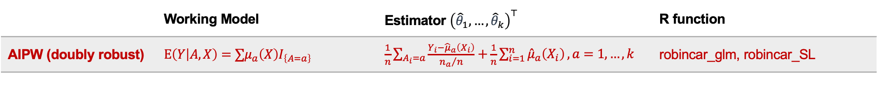
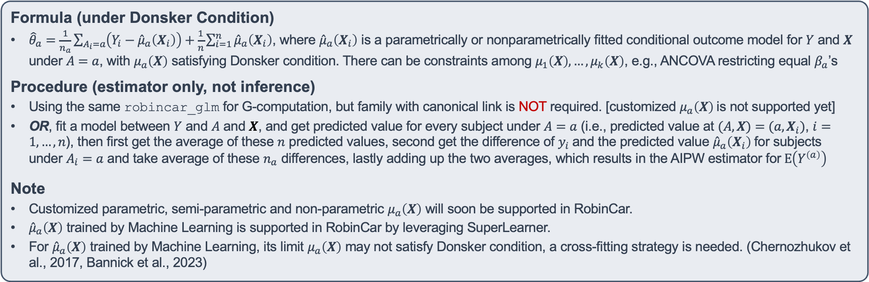
AIPW for Unconditional Treatment Effect
Estimand: any comparison of $E\left(Y^{\left(1\right)}\right),E\left(Y^{\left(2\right)}\right),…,E\left(Y^{\left(k\right)}\right)$
Method of Estimation:
 | Working Model | Estimator ${\left({\hat{θ}}_{1},…,{\hat{θ}}_{k}\right)}^{⊤}$ | R function
AIPW (doubly robust) | $E\left(Y | A, X\right)=∑μ_{a}\left(X\right)I_{\left\{A=a\right\}}$ | $\frac{1}{n}\sum_{A_{i}=a}{\frac{Y_{i}−{\hat{μ}}_{a}\left(X_{i}\right)}{{n_{a}}/n}}+\frac{1}{n}\sum_{i=1}^{n}{{\hat{μ}}_{a}\left(X_{i}\right)}, a=1,…,k$ | robincar_glm, robincar_SL
Formula (under Donsker Condition)
${\hat{θ}}_{a}=\frac{1}{n_{a}}\sum_{A_{i}=a}{\left(Y_{i}−{\hat{μ}}_{a}\left(X_{i}\right)\right)}+\frac{1}{n}\sum_{i=1}^{n}{{\hat{μ}}_{a}\left(X_{i}\right)}$, where ${\hat{μ}}_{a}\left(X_{i}\right)$ is a parametrically or nonparametrically fitted conditional outcome model for $Y$ and $X$ under $A=a$, with $μ_{a}\left(X\right)$ satisfying Donsker condition. There can be constraints among $μ_{1}\left(X\right),…,μ_{k}\left(X\right)$, e.g., ANCOVA restricting equal $β_{a}$’s
Procedure (estimator only, not inference)
Using the same robincar_glm for G-computation, but family with canonical link is NOT required. [customized $μ_{a}\left(X\right)$ is not supported yet]
OR, fit a model between $Y$ and $A$ and $X$, and get predicted value for every subject under $A=a$ (i.e., predicted value at $(A,X)=(a, X_{i})$, $i=1,…,n$), then first get the average of these $n$ predicted values, second get the difference of $y_{i}$ and the predicted value ${\hat{μ}}_{a}\left(X_{i}\right)$ for subjects under $A_{i}=a$ and take average of these $n_{a}$ differences, lastly adding up the two averages, which results in the AIPW estimator for $E\left(Y^{\left(a\right)}\right)$
Note
Customized parametric, semi-parametric and non-parametric $μ_{a}\left(X\right)$ will soon be supported in RobinCar.
${\hat{μ}}_{a}\left(X\right)$ trained by Machine Learning is supported in RobinCar by leveraging SuperLearner.
For ${\hat{μ}}_{a}\left(X\right)$ trained by Machine Learning, its limit $μ_{a}\left(X\right)$ may not satisfy Donsker condition, a cross-fitting strategy is needed. (Chernozhukov et al., 2017, Bannick et al., 2023)

Slide 27
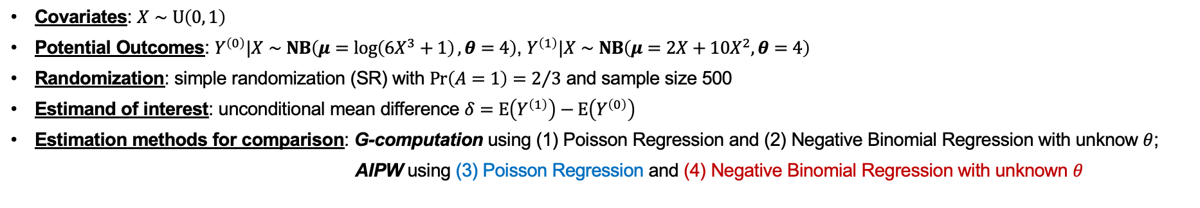
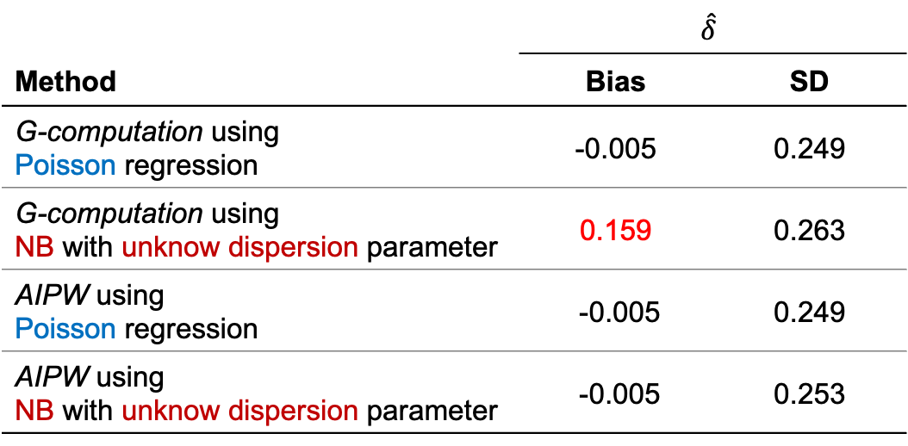
Simulation (AIPW is more general than G-computation)
Covariates: $X∼U\left(0, 1\right)$
Potential Outcomes: $Y^{\left(0\right)}|X∼NB\left(μ=\log\left(6X^{3}+1\right), θ=4\right)$, $Y^{\left(1\right)}|X∼NB\left(μ=2X+10X^{2}, θ=4\right)$
Randomization: simple randomization (SR) with $Pr\left(A=1\right)=2/3$ and sample size 500
Estimand of interest: unconditional mean difference $δ=E\left(Y^{\left(1\right)}\right)−E\left(Y^{\left(0\right)}\right)$
Estimation methods for comparison: G-computation using (1) Poisson Regression and (2) Negative Binomial Regression with unknow $θ$;
AIPW using (3) Poisson Regression and (4) Negative Binomial Regression with unknown $θ$
 | $$\hat{δ}$$
Method | Bias | SD
G-computation using Poisson regression | -0.005 | 0.249
G-computation using NB with unknow dispersion parameter | 0.159 | 0.263
AIPW using Poisson regression | -0.005 | 0.249
AIPW using NB with unknow dispersion parameter | -0.005 | 0.253
AIPW is always unbiased, regardless of using GLM with canonical link or not
Poisson regression uses “log” link, a canonical link, hence, G-computation is equal to AIPW.
Notes:
A gamma mixture of Poisson = rnegbin(mu, theta) = f(k; r=theta, p=theta/(mu+theta)) = k failures needed (kth failure) given r successes → modeling count data as failures (K) → E(k)=mu=r(1-p)/p and Var(k)=mu+mu^2/theta=r(1-p)/p^2
rnbinom(r, p) in R is generating n=r+k, which is the total independent Bernoulli trials that are needed to achieve r successes. E(n)=E(k) + r =

Slide 28
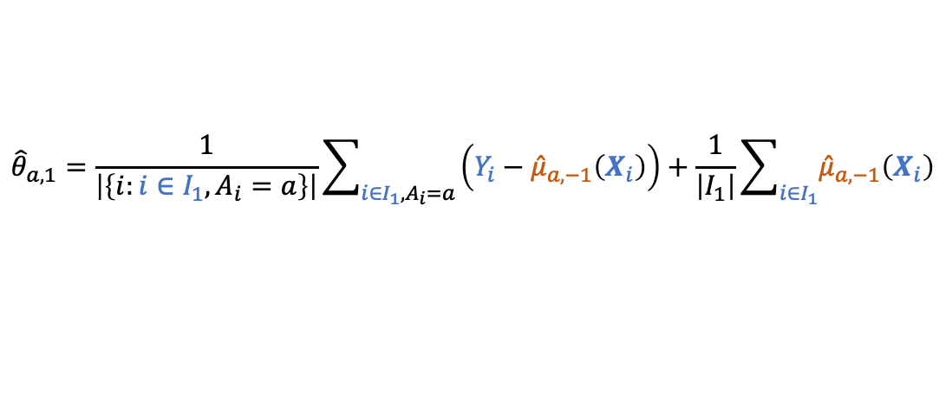
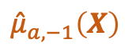
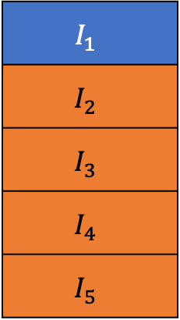
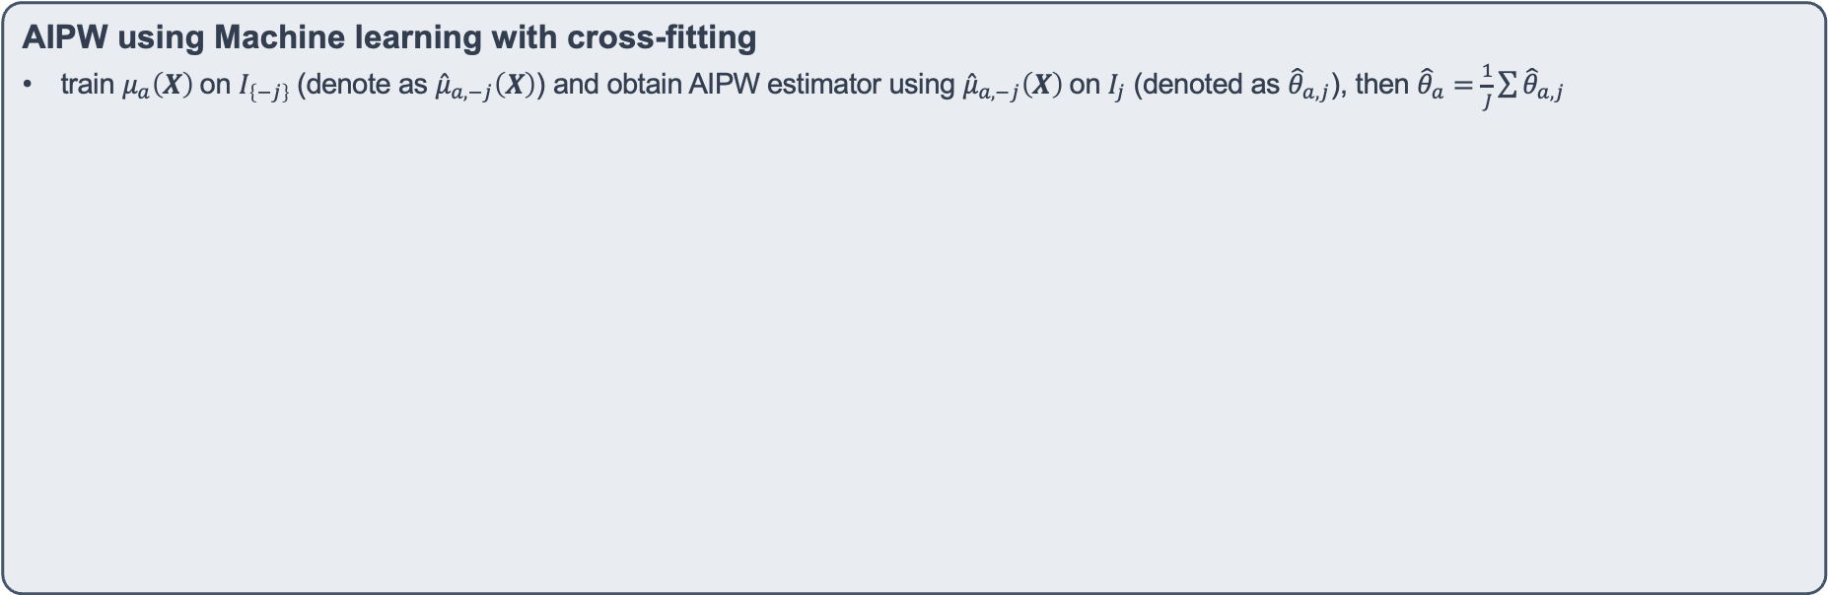
AIPW for Unconditional Treatment Effect
Estimand: any comparison of $E\left(Y^{\left(1\right)}\right),E\left(Y^{\left(2\right)}\right),…,E\left(Y^{\left(k\right)}\right)$
Method of Estimation:
 | Working Model | Estimator ${\left({\hat{θ}}_{1},…,{\hat{θ}}_{k}\right)}^{⊤}$ | R function
AIPW (doubly robust) | $E\left(Y | A, X\right)=∑μ_{a}\left(X\right)I_{\left\{A=a\right\}}$ | $\frac{1}{n}\sum_{A_{i}=a}{\frac{Y_{i}−{\hat{μ}}_{a}\left(X_{i}\right)}{{n_{a}}/n}}+\frac{1}{n}\sum_{i=1}^{n}{{\hat{μ}}_{a}\left(X_{i}\right)}, a=1,…,k$ | robincar_glm, robincar_SL
AIPW using Machine learning with cross-fitting
train $μ_{a}\left(X\right)$ on $I_{\left\{−j\right\}}$(denote as ${\hat{μ}}_{a,−j}\left(X\right)$) and obtain AIPW estimator using ${\hat{μ}}_{a,−j}\left(X\right)$on $I_{j}$ (denoted as ${\hat{θ}}_{a,j}$), then ${\hat{θ}}_{a}=\frac{1}{J}\sum{{\hat{θ}}_{a,j}}$
$$I_{1}$$
$$I_{2}$$
$$I_{3}$$
$$I_{4}$$
$$I_{5}$$
$${\hat{θ}}_{a,1}=\frac{1}{\left|\left\{i:i∈I_{1}, A_{i}=a\right\}\right|}\sum_{i∈I_{1}, A_{i}=a}{\left(Y_{i}−{\hat{μ}}_{a,−1}\left(X_{i}\right)\right)}+\frac{1}{\left|I_{1}\right|}\sum_{i∈I_{1}}{{\hat{μ}}_{a,−1}\left(X_{i}\right)}$$
$${\hat{μ}}_{a,−1}\left(X\right)$$

Slide 29
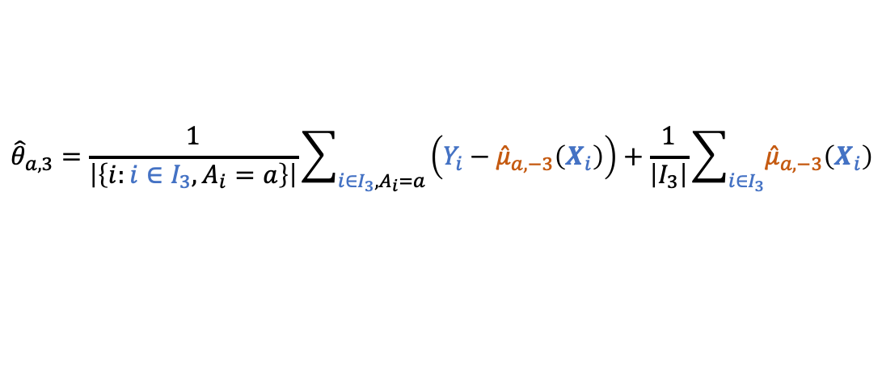
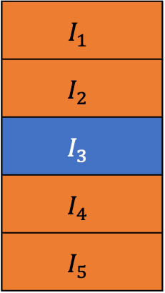
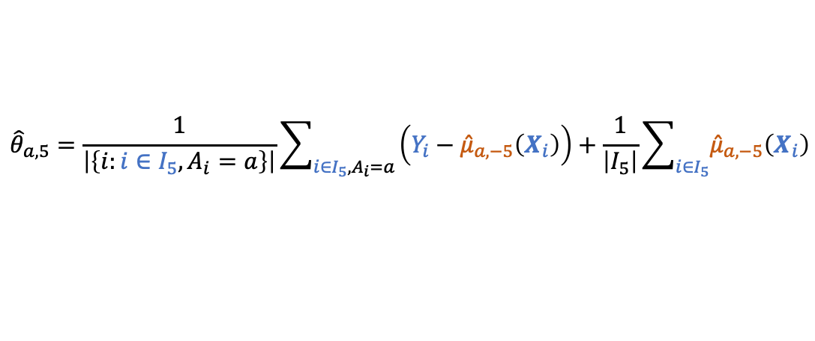
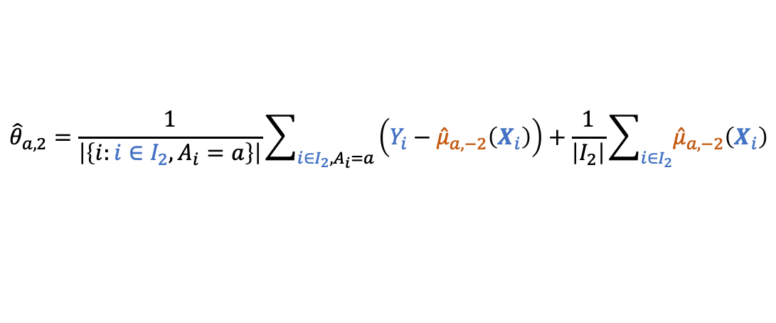
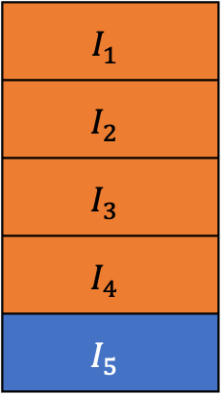
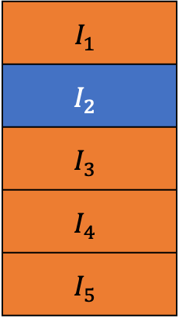
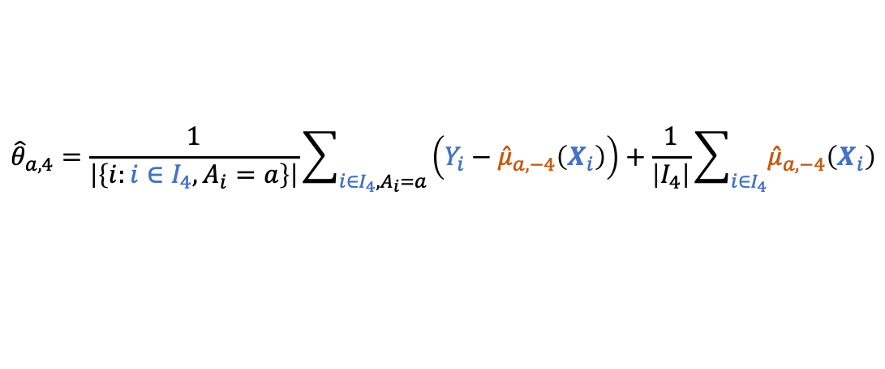
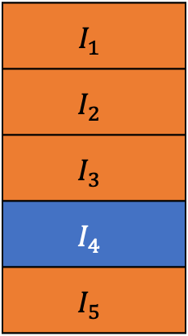
AIPW for Unconditional Treatment Effect
Estimand: any comparison of $E\left(Y^{\left(1\right)}\right),E\left(Y^{\left(2\right)}\right),…,E\left(Y^{\left(k\right)}\right)$
Method of Estimation:
 | Working Model | Estimator ${\left({\hat{θ}}_{1},…,{\hat{θ}}_{k}\right)}^{⊤}$ | R function
AIPW (doubly robust) | $E\left(Y | A, X\right)=∑μ_{a}\left(X\right)I_{\left\{A=a\right\}}$ | $\frac{1}{n}\sum_{A_{i}=a}{\frac{Y_{i}−{\hat{μ}}_{a}\left(X_{i}\right)}{{n_{a}}/n}}+\frac{1}{n}\sum_{i=1}^{n}{{\hat{μ}}_{a}\left(X_{i}\right)}, a=1,…,k$ | robincar_glm, robincar_SL
AIPW using Machine learning with cross-fitting
train $μ_{a}\left(X\right)$ on $I_{\left\{−j\right\}}$(denote as ${\hat{μ}}_{a,−j}\left(X\right)$) and obtain AIPW estimator using ${\hat{μ}}_{a,−j}\left(X\right)$on $I_{j}$ (denoted as ${\hat{θ}}_{a,j}$), then ${\hat{θ}}_{a}=\frac{1}{J}\sum{{\hat{θ}}_{a,j}}$
$$I_{1}$$
$$I_{2}$$
$$I_{3}$$
$$I_{4}$$
$$I_{5}$$
$$I_{1}$$
$$I_{2}$$
$$I_{3}$$
$$I_{4}$$
$$I_{5}$$
$$I_{1}$$
$$I_{2}$$
$$I_{3}$$
$$I_{4}$$
$$I_{5}$$
$$I_{1}$$
$$I_{2}$$
$$I_{3}$$
$$I_{4}$$
$$I_{5}$$
$${\hat{θ}}_{a,2}=\frac{1}{\left|\left\{i:i∈I_{2}, A_{i}=a\right\}\right|}\sum_{i∈I_{2}, A_{i}=a}{\left(Y_{i}−{\hat{μ}}_{a,−2}\left(X_{i}\right)\right)}+\frac{1}{\left|I_{2}\right|}\sum_{i∈I_{2}}{{\hat{μ}}_{a,−2}\left(X_{i}\right)}$$
$${\hat{θ}}_{a,3}=\frac{1}{\left|\left\{i:i∈I_{3}, A_{i}=a\right\}\right|}\sum_{i∈I_{3}, A_{i}=a}{\left(Y_{i}−{\hat{μ}}_{a,−3}\left(X_{i}\right)\right)}+\frac{1}{\left|I_{3}\right|}\sum_{i∈I_{3}}{{\hat{μ}}_{a,−3}\left(X_{i}\right)}$$
$${\hat{θ}}_{a,4}=\frac{1}{\left|\left\{i:i∈I_{4}, A_{i}=a\right\}\right|}\sum_{i∈I_{4}, A_{i}=a}{\left(Y_{i}−{\hat{μ}}_{a,−4}\left(X_{i}\right)\right)}+\frac{1}{\left|I_{4}\right|}\sum_{i∈I_{4}}{{\hat{μ}}_{a,−4}\left(X_{i}\right)}$$
$${\hat{θ}}_{a,5}=\frac{1}{\left|\left\{i:i∈I_{5}, A_{i}=a\right\}\right|}\sum_{i∈I_{5}, A_{i}=a}{\left(Y_{i}−{\hat{μ}}_{a,−5}\left(X_{i}\right)\right)}+\frac{1}{\left|I_{5}\right|}\sum_{i∈I_{5}}{{\hat{μ}}_{a,−5}\left(X_{i}\right)}$$

Slide 30
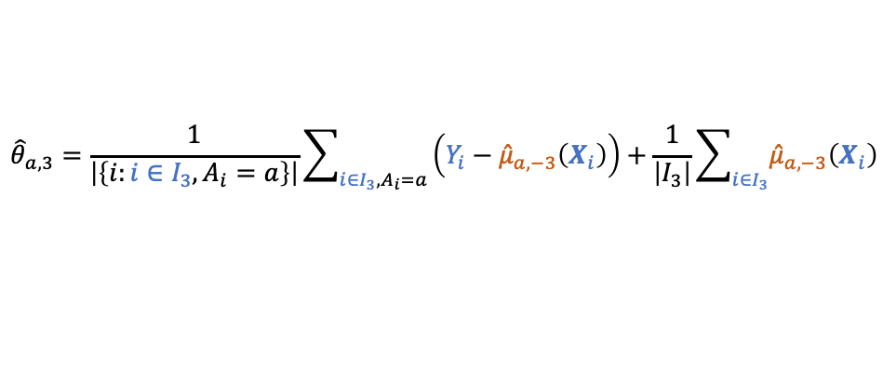
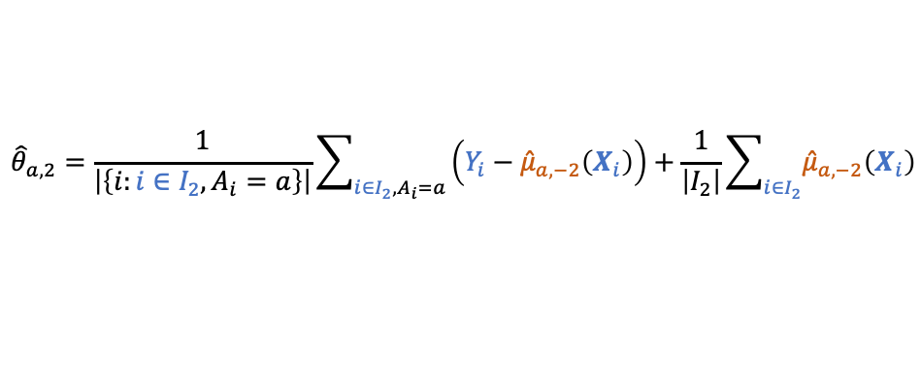
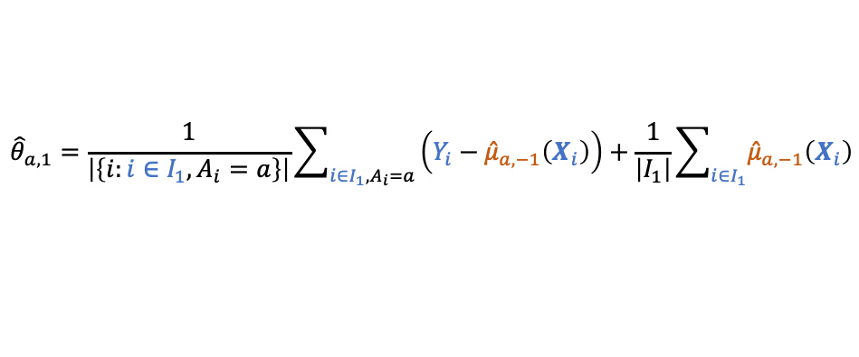
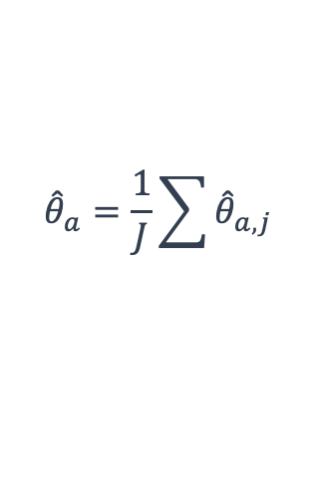
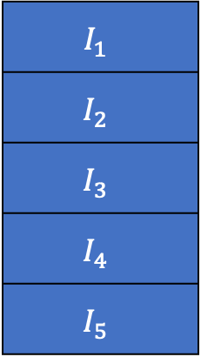

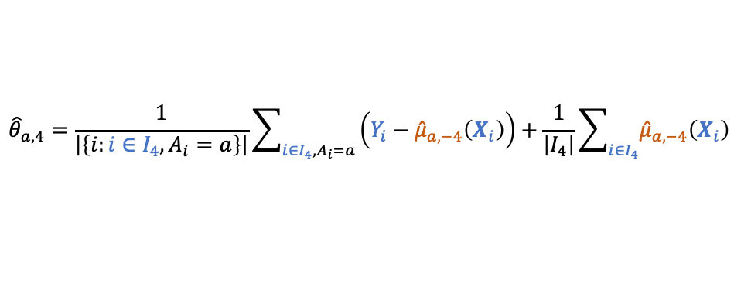
AIPW for Unconditional Treatment Effect
Estimand: any comparison of $E\left(Y^{\left(1\right)}\right),E\left(Y^{\left(2\right)}\right),…,E\left(Y^{\left(k\right)}\right)$
Method of Estimation:
 | Working Model | Estimator ${\left({\hat{θ}}_{1},…,{\hat{θ}}_{k}\right)}^{⊤}$ | R function
AIPW (doubly robust) | $E\left(Y | A, X\right)=∑μ_{a}\left(X\right)I_{\left\{A=a\right\}}$ | $\frac{1}{n}\sum_{A_{i}=a}{\frac{Y_{i}−{\hat{μ}}_{a}\left(X_{i}\right)}{{n_{a}}/n}}+\frac{1}{n}\sum_{i=1}^{n}{{\hat{μ}}_{a}\left(X_{i}\right)}, a=1,…,k$ | robincar_glm, robincar_SL
AIPW using Machine learning with cross-fitting
train $μ_{a}\left(X\right)$ on $I_{\left\{−j\right\}}$(denote as ${\hat{μ}}_{a,−j}\left(X\right)$) and obtain AIPW estimator using ${\hat{μ}}_{a,−j}\left(X\right)$on $I_{j}$ (denoted as ${\hat{θ}}_{a,j}$), then ${\hat{θ}}_{a}=\frac{1}{J}\sum{{\hat{θ}}_{a,j}}$
$$I_{1}$$
$$I_{2}$$
$$I_{3}$$
$$I_{4}$$
$$I_{5}$$
$${\hat{θ}}_{a,1}=\frac{1}{\left|\left\{i:i∈I_{1}, A_{i}=a\right\}\right|}\sum_{i∈I_{1}, A_{i}=a}{\left(Y_{i}−{\hat{μ}}_{a,−1}\left(X_{i}\right)\right)}+\frac{1}{\left|I_{1}\right|}\sum_{i∈I_{1}}{{\hat{μ}}_{a,−1}\left(X_{i}\right)}$$
$${\hat{θ}}_{a,2}=\frac{1}{\left|\left\{i:i∈I_{2}, A_{i}=a\right\}\right|}\sum_{i∈I_{2}, A_{i}=a}{\left(Y_{i}−{\hat{μ}}_{a,−2}\left(X_{i}\right)\right)}+\frac{1}{\left|I_{2}\right|}\sum_{i∈I_{2}}{{\hat{μ}}_{a,−2}\left(X_{i}\right)}$$
$${\hat{θ}}_{a,3}=\frac{1}{\left|\left\{i:i∈I_{3}, A_{i}=a\right\}\right|}\sum_{i∈I_{3}, A_{i}=a}{\left(Y_{i}−{\hat{μ}}_{a,−3}\left(X_{i}\right)\right)}+\frac{1}{\left|I_{3}\right|}\sum_{i∈I_{3}}{{\hat{μ}}_{a,−3}\left(X_{i}\right)}$$
$${\hat{θ}}_{a}=\frac{1}{J}\sum{{\hat{θ}}_{a,j}}$$
$${\hat{θ}}_{a,4}=\frac{1}{\left|\left\{i:i∈I_{4}, A_{i}=a\right\}\right|}\sum_{i∈I_{4}, A_{i}=a}{\left(Y_{i}−{\hat{μ}}_{a,−4}\left(X_{i}\right)\right)}+\frac{1}{\left|I_{4}\right|}\sum_{i∈I_{4}}{{\hat{μ}}_{a,−4}\left(X_{i}\right)}$$
$${\hat{θ}}_{a,5}=\frac{1}{\left|\left\{i:i∈I_{5}, A_{i}=a\right\}\right|}\sum_{i∈I_{5}, A_{i}=a}{\left(Y_{i}−{\hat{μ}}_{a,−5}\left(X_{i}\right)\right)}+\frac{1}{\left|I_{5}\right|}\sum_{i∈I_{5}}{{\hat{μ}}_{a,−5}\left(X_{i}\right)}$$

Slide 31
AIPW for Unconditional Treatment Effect
Estimand: any comparison of $E\left(Y^{\left(1\right)}\right),E\left(Y^{\left(2\right)}\right),…,E\left(Y^{\left(k\right)}\right)$
Method of Estimation:
 | Working Model | Estimator ${\left({\hat{θ}}_{1},…,{\hat{θ}}_{k}\right)}^{⊤}$ | R function
AIPW (doubly robust) | $E\left(Y | A, X\right)=∑μ_{a}\left(X\right)I_{\left\{A=a\right\}}$ | $\frac{1}{n}\sum_{A_{i}=a}{\frac{Y_{i}−{\hat{μ}}_{a}\left(X_{i}\right)}{{n_{a}}/n}}+\frac{1}{n}\sum_{i=1}^{n}{{\hat{μ}}_{a}\left(X_{i}\right)}, a=1,…,k$ | robincar_glm, robincar_SL
Practice 1 – Part III (details in Practice1.Rmd)
Use Fun_datagen(Fun.n=500, Fun.y.type=”count", Fun.rand="SR", Fun.p=2/3) to generate data with count outcome
(b) Read a hand-coded R function for AIPW (named Fun_aip)
Compare Fun_aipw and Fun_gcomp based on the simulated data set, with Poisson
Compare Fun_aipw and Fun_gcomp based on the simulated data set, with NB
Use robincar_glm to obtain AIPW estimator for the simulated data set, supplied with Poisson or NB
Generate 1000 simulated datasets with count outcome with Fun_aipw and summarize Bias and SD, compare with the Bias seen in Practice 1 - Part II from Fun_gcomp

Slide 32
Table of Content
Design Stage
Covariate-Adaptive Randomization
Analysis Stage
Estimand
Part I – Basic
Linear Adjustment [45 mins with practice + 15 mins break]
Nonlinear Adjustment (G-computation) [20 mins with practice]
General Form of Covariate Adjustment (AIPW) [40 mins with practice + 15 mins break]
Robust Variance Estimation and Delta method [60 mins with practice]
Part II – Advanced
Covariate Adjustment in Survival Analysis
Practical Considerations

Slide 33
Covariate Adjustment for Unconditional Treatment Effect
Estimand: any comparison of $E\left(Y^{\left(1\right)}\right),E\left(Y^{\left(2\right)}\right),…,E\left(Y^{\left(k\right)}\right)$
Method of Estimation:
 | Working Model | Estimator ${\left({\hat{θ}}_{1},…,{\hat{θ}}_{k}\right)}^{⊤}$ | R function
Unadjusted | $E\left(Y | A\right)=∑γ_{a}I_{\left\{A=a\right\}}$ | ${\hat{γ}}_{a}$, $a=1,…,k$ | robincar_linear
Linear adjustment | $E\left(Y | A, X\right)=∑\left(γ_{a}+β_{a}^{⊤}X\right)I_{\left\{A=a\right\}}$ | $${\hat{γ}}_{a}+{\hat{β}}_{a}^{⊤}\overline{X}, a=1,…,k$$ | robincar_linear
G-computation | $g\left(E\left(Y | A, X\right)\right)=∑\left(γ_{a}+β_{a}^{⊤}X\right)I_{\left\{A=a\right\}}$ | $\frac{1}{n}\sum_{i=1}^{n}{g^{−1}\left({\hat{γ}}_{a}+{\hat{β}}_{a}^{⊤}X_{i}\right)}, a=1,…,k$ | robincar_glm
AIPW (doubly robust) | $E\left(Y | A, X\right)=∑μ_{a}\left(X\right)I_{\left\{A=a\right\}}$ | $\frac{1}{n}\sum_{A_{i}=a}{\frac{Y_{i}−{\hat{μ}}_{a}\left(X_{i}\right)}{{n_{a}}/n}}+\frac{1}{n}\sum_{i=1}^{n}{{\hat{μ}}_{a}\left(X_{i}\right)}, a=1,…,k$ | robincar_glm, robincar_SL
the general form of covariate adjustment in randomized clinical trials
Notes:
Robust variance

Slide 34
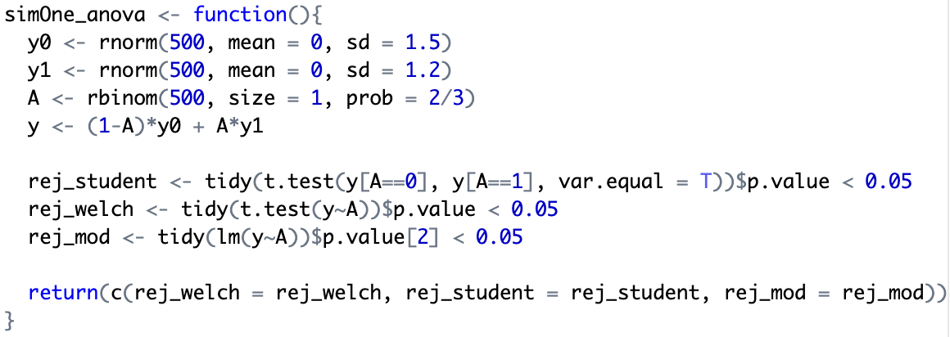


Robust Inference – one theory fits all
Estimand: any comparison of $E\left(Y^{\left(1\right)}\right),E\left(Y^{\left(2\right)}\right),…,E\left(Y^{\left(k\right)}\right)$
Method of Estimation:
 | Working Model | Estimator ${\left({\hat{θ}}_{1},…,{\hat{θ}}_{k}\right)}^{⊤}$ | R function
Unadjusted | $E\left(Y | A\right)=∑γ_{a}I_{\left\{A=a\right\}}$ | ${\hat{γ}}_{a}$, $a=1,…,k$ | robincar_linear
Model-based variance estimation is default in most statistical software, e.g., R or SAS. [FDA GUIDANCE 2023]
Let us try a simple simulation on ANOVA (unadjusted estimation): welch t-test, student t-test and linear model based ANOVA
Type-I-Error Inflated!!!

Slide 35




Robust Inference – one theory fits all
Estimand: any comparison of $E\left(Y^{\left(1\right)}\right),E\left(Y^{\left(2\right)}\right),…,E\left(Y^{\left(k\right)}\right)$
Method of Estimation:
 | Working Model | Estimator ${\left({\hat{θ}}_{1},…,{\hat{θ}}_{k}\right)}^{⊤}$ | R function
Unadjusted | $E\left(Y | A\right)=∑γ_{a}I_{\left\{A=a\right\}}$ | ${\hat{γ}}_{a}$, $a=1,…,k$ | robincar_linear
Model-based variance estimation is default in most statistical software, e.g., R or SAS. [FDA GUIDANCE 2023]
Let us try a simple simulation on ANOVA (unadjusted estimation): welch t-test, student t-test and linear model based ANOVA
welch t-test controls type-I-error well, but student t-test and linear model based ANOVA behave the same and can inflate type-I-error
Given the numerator of these three test statistics are identical, simple sample mean difference (unadjusted estimator), type-I-error is impacted by the denominator of these three test statistics, i.e., the variance estimation of the numerator.
What is assumed for model based ANOVA and what is the corresponding model based variance estimation?
$Y_{i}=∑γ_{a}I_{\left\{A=a\right\}}+ε_{i}$ with $ε_{i}|A_{i}\sim _{i.i.d.}N(0, σ^{2})$ where $A_{i}$ is assumed fixed (which is not true in RCT) in conventional linear regression
It implies equal variance for outcomes across treatment groups, i.e., $Var\left(Y^{\left(1\right)}\right)=⋯=Var\left(Y^{\left(k\right)}\right)$, which may NOT be true and is NOT included in minimal statistical assumptions made at the beginning of the short course
$$\hat{Var\left({\overline{Y}}_{1}\right)}=\sqrt{s_{p}^{2}/n_{1}}$$
$$s_{p}=\sqrt{\frac{\left(n_{1}−1\right)S_{1}^{2}+\left(n_{2}−1\right)S_{2}^{2}}{n_{1}+n_{2}−2}}$$
* take $k=2$, i.e., $a∈\{1,2\}$as example
If equal variance assumption does not hold, $S_{2}^{2}$, the sample variance of the outcome under treatment 2 may over/under-estimate true $Var\left(Y^{\left(1\right)}\right)$

Slide 36

Robust Inference – one theory fits all
Estimand: any comparison of $E\left(Y^{\left(1\right)}\right),E\left(Y^{\left(2\right)}\right),…,E\left(Y^{\left(k\right)}\right)$
Method of Estimation:
 | Working Model | Estimator ${\left({\hat{θ}}_{1},…,{\hat{θ}}_{k}\right)}^{⊤}$ | R function
Unadjusted | $E\left(Y | A\right)=∑γ_{a}I_{\left\{A=a\right\}}$ | ${\hat{γ}}_{a}$, $a=1,…,k$ | robincar_linear
Model-based variance estimation is default in most statistical software, e.g., R or SAS. [FDA GUIDANCE 2023]
Let us try a simple simulation on ANOVA (unadjusted estimation): welch t-test, student t-test and linear model based ANOVA
welch t-test controls type-I-error well, but student t-test and linear model based ANOVA behave the same and can inflate type-I-error
Given the numerator of these three test statistics are identical, simple sample mean difference (unadjusted estimator), type-I-error is impacted by the denominator of these three test statistics, i.e., the variance estimation of the numerator.
What is assumed for model based ANOVA and what is the corresponding model based variance estimation?
$Y_{i}=∑γ_{a}I_{\left\{A=a\right\}}+ε_{i}$ with $ε_{i}|A_{i}\sim _{i.i.d.}N(0, σ^{2})$ where $A_{i}$ is assumed fixed (which is not true in RCT) in conventional linear regression
What do we learn from the robustness of Welch t-test statistics (unequal variance)? [asymptotic inference]
Without making any assumptions other than the minimal statistical assumptions made at the beginning of the course, simply by CLT, we have
$$\sqrt{n}\left[{\left({\overline{Y}}_{1},…,{\overline{Y}}_{k}\right)}^{⊤}−{\left(E\left(Y^{\left(1\right)}\right),E\left(Y^{\left(2\right)}\right),…,E\left(Y^{\left(k\right)}\right)\right)}^{⊤}\right] \underset{→}{ d } N\left[0, diag\left(Var(Y^{\left(1\right) },…,Var(Y^{(k)}\right)\right]$$
$Var\left(Y^{\left(a\right)}\right)$ can be estimated by $S_{a}^{2}$, the sample variance of the outcome under treatment $a$, because of randomization

Slide 37


Robust Inference – one theory fits all
Estimand: any comparison of $E\left(Y^{\left(1\right)}\right),E\left(Y^{\left(2\right)}\right),…,E\left(Y^{\left(k\right)}\right)$
Method of Estimation:
Robust Inference (asymptotic theory):
$$\sqrt{n}\left[{\left({\hat{θ}}_{1},…,{\hat{θ}}_{k}\right)}^{⊤}−{\left(E\left(Y^{\left(1\right)}\right),E\left(Y^{\left(2\right)}\right),…,E\left(Y^{\left(k\right)}\right)\right)}^{⊤}\right] \underset{→}{ d } N\left[0, V\right]$$
where
$$V=diag\left\{π_{a}^{−1}Var\left(Y^{\left(a\right)}−μ_{a}\left(X\right)\right), a=1,…,k\right\}+Cov\left(Y, μ\left(X\right)\right)+Cov\left(μ\left(X\right), Y\right)−Var\left(μ\left(X\right)\right)−E\left(\left(R_{Y}\left(Z\right)−R_{X}\left(Z\right)\right)\left(Ω_{SR}−Ω\left(Z\right)\right)\left(R_{Y}\left(Z\right)−R_{X}\left(Z\right)\right)\right)$$
with $π_{a}=Pr\left(A=a\right)$, $Y={\left(Y^{\left(1\right)},…,Y^{\left(k\right)}\right)}^{⊤}$, $μ\left(X\right)={\left(μ_{1}\left(X\right),…,μ_{k}\left(X\right)\right)}^{⊤}$,
$R_{Y}\left(Z\right)=diag\left\{π_{a}^{−1}E\left(Y^{\left(a\right)}−E\left(Y^{\left(a\right)}\right)|Z\right), a=1,…,k\right\}$, $R_{X}\left(Z\right)=diag\left\{π_{a}^{−1}E\left(μ_{a}\left(X\right)−E\left(μ_{a}\left(X\right)\right)|Z\right), a=1,…,k\right\}$,
$Ω(Z)$ is related to covariate-adaptive randomization and $Ω_{SR}$ is $Ω\left(Z\right)$ under simple randomization, and $Z$ is the stratification factor.
 | Working Model | Estimator ${\left({\hat{θ}}_{1},…,{\hat{θ}}_{k}\right)}^{⊤}$ | R function
AIPW (doubly robust) | $E\left(Y | A, X\right)=∑μ_{a}\left(X\right)I_{\left\{A=a\right\}}$ | $\frac{1}{n}\sum_{A_{i}=a}{\frac{Y_{i}−{\hat{μ}}_{a}\left(X_{i}\right)}{{n_{a}}/n}}+\frac{1}{n}\sum_{i=1}^{n}{{\hat{μ}}_{a}\left(X_{i}\right)}, a=1,…,k$ | robincar_glm, robincar_SL
Asymptotic Variance under SR
Variance Adjustment (reduction) for CAR
Notes:
Robust variance

Slide 38


Robust Inference – one theory fits all
Estimand: any comparison of $E\left(Y^{\left(1\right)}\right),E\left(Y^{\left(2\right)}\right),…,E\left(Y^{\left(k\right)}\right)$
Method of Estimation:
Robust Inference (asymptotic theory):
$$\sqrt{n}\left[{\left({\hat{θ}}_{1},…,{\hat{θ}}_{k}\right)}^{⊤}−{\left(E\left(Y^{\left(1\right)}\right),E\left(Y^{\left(2\right)}\right),…,E\left(Y^{\left(k\right)}\right)\right)}^{⊤}\right] \underset{→}{ d } N\left[0, V\right]$$
Where $V=diag\left\{π_{a}^{−1}Var\left(Y^{\left(a\right)}−μ_{a}\left(X\right)\right), a=1,…,k\right\}+Cov\left(Y, μ\left(X\right)\right)+Cov\left(μ\left(X\right), Y\right)−Var\left(μ\left(X\right)\right)−E\left(\left(R_{Y}\left(Z\right)−R_{X}\left(Z\right)\right)\left(Ω_{SR}−Ω\left(Z\right)\right)\left(R_{Y}\left(Z\right)−R_{X}\left(Z\right)\right)\right)$
with $π_{a}=Pr\left(A=a\right)$, $Y={\left(Y^{\left(1\right)},…,Y^{\left(k\right)}\right)}^{⊤}$, $μ\left(X\right)={\left(μ_{1}\left(X\right),…,μ_{k}\left(X\right)\right)}^{⊤}$, $R_{Y}\left(Z\right)=diag\left\{π_{a}^{−1}E\left(Y^{\left(a\right)}−E\left(Y^{\left(a\right)}\right)|Z\right), a=1,…,k\right\}$, $R_{X}\left(Z\right)=diag\left\{π_{a}^{−1}E\left(μ_{a}\left(X\right)−E\left(μ_{a}\left(X\right)\right)|Z\right), a=1,…,k\right\}$, $Ω(Z)$ is related to covariate-adaptive randomization and $Ω_{SR}$ is $Ω\left(Z\right)$ under simple randomization, and $Z$ is the stratification factor.
Delta Method for treatment effect (comparison) estimation
$$\sqrt{n}\left[h\left({\hat{θ}}_{1},…,{\hat{θ}}_{k}\right)−h\left(E\left(Y^{\left(1\right)}\right),E\left(Y^{\left(2\right)}\right),…,E\left(Y^{\left(k\right)}\right)\right)\right] \underset{→}{ d } N\left[0, {\left\{∇h\left(E\left(Y^{\left(1\right)}\right),E\left(Y^{\left(2\right)}\right),…,E\left(Y^{\left(k\right)}\right)\right)\right\}}^{⊤}V\left\{∇h\left(E\left(Y^{\left(1\right)}\right),E\left(Y^{\left(2\right)}\right),…,E\left(Y^{\left(k\right)}\right)\right)\right\}\right]$$
 | Working Model | Estimator ${\left({\hat{θ}}_{1},…,{\hat{θ}}_{k}\right)}^{⊤}$ | R function
AIPW (doubly robust) | $E\left(Y | A, X\right)=∑μ_{a}\left(X\right)I_{\left\{A=a\right\}}$ | $\frac{1}{n}\sum_{A_{i}=a}{\frac{Y_{i}−{\hat{μ}}_{a}\left(X_{i}\right)}{{n_{a}}/n}}+\frac{1}{n}\sum_{i=1}^{n}{{\hat{μ}}_{a}\left(X_{i}\right)}, a=1,…,k$ | robincar_glm, robincar_SL
Commonly used $h\left(⋅\right)$: 1) mean difference, e.g., $θ_{2}−θ_{1}$; 2) ratio e.g., $θ_{2}/θ_{1}$; 3) odds ratio, $\left\{{θ_{2}}/{\left(1−θ_{2}\right)}\right\}−\left\{{θ_{1}}/{\left(1−θ_{1}\right)}\right\}$
Note that, for ratio and odds ratio, it is recommended (Haldane, 1956; Woolf, 1955) to apply delta method to log(ratio) and log(odds ratio) first, then hypothesis testing and p-value are based on log-scale, while CI for ratio or odds ratio is simply taking exponential of the lower/higher CI of the log-scaled CI.
Notes:
Robust variance

Slide 39

Robust Inference – one theory fits all
Estimand: any comparison of $E\left(Y^{\left(1\right)}\right),E\left(Y^{\left(2\right)}\right),…,E\left(Y^{\left(k\right)}\right)$
Method of Estimation:
Robust Inference (asymptotic theory + delta method):
$$\sqrt{n}\left[h\left({\hat{θ}}_{1},…,{\hat{θ}}_{k}\right)−h\left(E\left(Y^{\left(1\right)}\right),E\left(Y^{\left(2\right)}\right),…,E\left(Y^{\left(k\right)}\right)\right)\right] \underset{→}{ d } N\left[0, {\left\{∇h\left(E\left(Y^{\left(1\right)}\right),E\left(Y^{\left(2\right)}\right),…,E\left(Y^{\left(k\right)}\right)\right)\right\}}^{⊤}V\left\{∇h\left(E\left(Y^{\left(1\right)}\right),E\left(Y^{\left(2\right)}\right),…,E\left(Y^{\left(k\right)}\right)\right)\right\}\right]$$
Where $V=diag\left\{π_{a}^{−1}Var\left(Y^{\left(a\right)}−μ_{a}\left(X\right)\right), a=1,…,k\right\}+Cov\left(Y, μ\left(X\right)\right)+Cov\left(μ\left(X\right), Y\right)−Var\left(μ\left(X\right)\right)−E\left(\left(R_{Y}\left(Z\right)−R_{X}\left(Z\right)\right)\left(Ω_{SR}−Ω\left(Z\right)\right)\left(R_{Y}\left(Z\right)−R_{X}\left(Z\right)\right)\right)$
and $h(⋅)$represents the comparisons among treatments, with $π_{a}=Pr\left(A=a\right)$, $Y={\left(Y^{\left(1\right)},…,Y^{\left(k\right)}\right)}^{⊤}$, $μ\left(X\right)={\left(μ_{1}\left(X\right),…,μ_{k}\left(X\right)\right)}^{⊤}$, $R_{Y}\left(Z\right)=diag\left\{π_{a}^{−1}E\left(Y^{\left(a\right)}−E\left(Y^{\left(a\right)}\right)|Z\right), a=1,…,k\right\}$, $R_{X}\left(Z\right)=diag\left\{π_{a}^{−1}E\left(μ_{a}\left(X\right)−E\left(μ_{a}\left(X\right)\right)|Z\right), a=1,…,k\right\}$, $Ω(Z)$ is related to covariate-adaptive randomization and $Ω_{SR}$ is $Ω\left(Z\right)$ under simple randomization, and $Z$ is the stratification factor.
 | Working Model | Estimator ${\left({\hat{θ}}_{1},…,{\hat{θ}}_{k}\right)}^{⊤}$ | R function
AIPW (doubly robust) | $E\left(Y | A, X\right)=∑μ_{a}\left(X\right)I_{\left\{A=a\right\}}$ | $\frac{1}{n}\sum_{A_{i}=a}{\frac{Y_{i}−{\hat{μ}}_{a}\left(X_{i}\right)}{{n_{a}}/n}}+\frac{1}{n}\sum_{i=1}^{n}{{\hat{μ}}_{a}\left(X_{i}\right)}, a=1,…,k$ | robincar_glm, robincar_SL
Procedure
First, use robincar_linear, robincar_glm or robincar_SL to get the joint asymptotic normality of the estimators for all treatments
Then, use robincar_contrast to apply delta method to the output of the robincar_linear, robincar_glm or robincar_SL
Delta method can also be applied within robincar_linear, robincar_glm or robincar_SL with option contrast_h being pre-specified.
Usually contrast_dh is not needed, numerical derivative of contrast_h will be applied by default.
Notes:
Robust variance

Slide 40


Robust Inference – one theory fits all
Estimand: any comparison of $E\left(Y^{\left(1\right)}\right),E\left(Y^{\left(2\right)}\right),…,E\left(Y^{\left(k\right)}\right)$
Method of Estimation:
Robust Inference (asymptotic theory + delta method):
$$\sqrt{n}\left[h\left({\hat{θ}}_{1},…,{\hat{θ}}_{k}\right)−h\left(E\left(Y^{\left(1\right)}\right),E\left(Y^{\left(2\right)}\right),…,E\left(Y^{\left(k\right)}\right)\right)\right] \underset{→}{ d } N\left[0, {\left\{∇h\left(E\left(Y^{\left(1\right)}\right),E\left(Y^{\left(2\right)}\right),…,E\left(Y^{\left(k\right)}\right)\right)\right\}}^{⊤}V\left\{∇h\left(E\left(Y^{\left(1\right)}\right),E\left(Y^{\left(2\right)}\right),…,E\left(Y^{\left(k\right)}\right)\right)\right\}\right]$$
Where $V=diag\left\{π_{a}^{−1}Var\left(Y^{\left(a\right)}−μ_{a}\left(X\right)\right), a=1,…,k\right\}+Cov\left(Y, μ\left(X\right)\right)+Cov\left(μ\left(X\right), Y\right)−Var\left(μ\left(X\right)\right)−E\left(\left(R_{Y}\left(Z\right)−R_{X}\left(Z\right)\right)\left(Ω_{SR}−Ω\left(Z\right)\right)\left(R_{Y}\left(Z\right)−R_{X}\left(Z\right)\right)\right)$
and $h(⋅)$represents the comparisons among treatments, with $π_{a}=Pr\left(A=a\right)$, $Y={\left(Y^{\left(1\right)},…,Y^{\left(k\right)}\right)}^{⊤}$, $μ\left(X\right)={\left(μ_{1}\left(X\right),…,μ_{k}\left(X\right)\right)}^{⊤}$, $R_{Y}\left(Z\right)=diag\left\{π_{a}^{−1}E\left(Y^{\left(a\right)}−E\left(Y^{\left(a\right)}\right)|Z\right), a=1,…,k\right\}$, $R_{X}\left(Z\right)=diag\left\{π_{a}^{−1}E\left(μ_{a}\left(X\right)−E\left(μ_{a}\left(X\right)\right)|Z\right), a=1,…,k\right\}$, $Ω(Z)$ is related to covariate-adaptive randomization and $Ω_{SR}$ is $Ω\left(Z\right)$ under simple randomization, and $Z$ is the stratification factor.
 | Working Model | Estimator ${\left({\hat{θ}}_{1},…,{\hat{θ}}_{k}\right)}^{⊤}$ | R function
AIPW (doubly robust) | $E\left(Y | A, X\right)=∑μ_{a}\left(X\right)I_{\left\{A=a\right\}}$ | $\frac{1}{n}\sum_{A_{i}=a}{\frac{Y_{i}−{\hat{μ}}_{a}\left(X_{i}\right)}{{n_{a}}/n}}+\frac{1}{n}\sum_{i=1}^{n}{{\hat{μ}}_{a}\left(X_{i}\right)}, a=1,…,k$ | robincar_glm, robincar_SL
Practice 1 – SR (details in Practice1.rmd)
Use Fun_datagen(Fun.n=500, Fun.y.type=”count", Fun.rand=”CAR", Fun.p=2/3) to generate data with count outcome under CAR
Create treatment contrast function $h$ for mean difference and mean ratio, name them as Fun_h_diff, Fun_h_logratio, respectively
Obtain joint normality of ANCOVA, ANHECOVA and AIPW estimators with adjustment for Xc and Xb, not accounting for CAR
Use robincar_contrast to obtain mean difference and mean ratio estimator based on ANCOVA, ANHECOVA and AIPW estimators
Supply contrast_h directly in robincar_linear and robincar_glm
Notes:
Robust variance

Slide 41
Robust Inference – one theory fits all
Estimand: any comparison of $E\left(Y^{\left(1\right)}\right),E\left(Y^{\left(2\right)}\right),…,E\left(Y^{\left(k\right)}\right)$
Method of Estimation:
Robust Inference (asymptotic theory + delta method):
$$\sqrt{n}\left[h\left({\hat{θ}}_{1},…,{\hat{θ}}_{k}\right)−h\left(E\left(Y^{\left(1\right)}\right),E\left(Y^{\left(2\right)}\right),…,E\left(Y^{\left(k\right)}\right)\right)\right] \underset{→}{ d } N\left[0, {\left\{∇h\left(E\left(Y^{\left(1\right)}\right),E\left(Y^{\left(2\right)}\right),…,E\left(Y^{\left(k\right)}\right)\right)\right\}}^{⊤}V\left\{∇h\left(E\left(Y^{\left(1\right)}\right),E\left(Y^{\left(2\right)}\right),…,E\left(Y^{\left(k\right)}\right)\right)\right\}\right]$$
Where $V=diag\left\{π_{a}^{−1}Var\left(Y^{\left(a\right)}−μ_{a}\left(X\right)\right), a=1,…,k\right\}+Cov\left(Y, μ\left(X\right)\right)+Cov\left(μ\left(X\right), Y\right)−Var\left(μ\left(X\right)\right)−E\left(\left(R_{Y}\left(Z\right)−R_{X}\left(Z\right)\right)\left(Ω_{SR}−Ω\left(Z\right)\right)\left(R_{Y}\left(Z\right)−R_{X}\left(Z\right)\right)\right)$
and $h(⋅)$represents the comparisons among treatments, with $π_{a}=Pr\left(A=a\right)$, $Y={\left(Y^{\left(1\right)},…,Y^{\left(k\right)}\right)}^{⊤}$, $μ\left(X\right)={\left(μ_{1}\left(X\right),…,μ_{k}\left(X\right)\right)}^{⊤}$, $R_{Y}\left(Z\right)=diag\left\{π_{a}^{−1}E\left(Y^{\left(a\right)}−E\left(Y^{\left(a\right)}\right)|Z\right), a=1,…,k\right\}$, $R_{X}\left(Z\right)=diag\left\{π_{a}^{−1}E\left(μ_{a}\left(X\right)−E\left(μ_{a}\left(X\right)\right)|Z\right), a=1,…,k\right\}$, $Ω(Z)$ is related to covariate-adaptive randomization and $Ω_{SR}$ is $Ω\left(Z\right)$ under simple randomization, and $Z$ is the stratification factor.
 | Working Model | Estimator ${\left({\hat{θ}}_{1},…,{\hat{θ}}_{k}\right)}^{⊤}$ | R function
AIPW (doubly robust) | $E\left(Y | A, X\right)=∑μ_{a}\left(X\right)I_{\left\{A=a\right\}}$ | $\frac{1}{n}\sum_{A_{i}=a}{\frac{Y_{i}−{\hat{μ}}_{a}\left(X_{i}\right)}{{n_{a}}/n}}+\frac{1}{n}\sum_{i=1}^{n}{{\hat{μ}}_{a}\left(X_{i}\right)}, a=1,…,k$ | robincar_glm, robincar_SL
Practice – CAR (details in Practice1.rmd)
Re-use the previously simulated data set and the contrast function Fun_h_diff and Fun_h_ratio
Obtain joint normality of ANCOVA, ANHECOVA and AIPW estimators with adjustment for Xc, Xb and Z, accounting for CAR
Use robincar_contrast to obtain mean difference and mean ratio estimator based on ANCOVA, ANHECOVA and AIPW estimators
Compare the estimates and corresponding SE with previous results not accounting for CAR
Notes:
Robust variance

Slide 42

Covariate Adjustment for Unconditional Treatment Effect
Estimand: any comparison of $E\left(Y^{\left(1\right)}\right),E\left(Y^{\left(2\right)}\right),…,E\left(Y^{\left(k\right)}\right)$
Method of Estimation:
Robust Inference (asymptotic theory):
$$\sqrt{n}\left[{\left({\hat{θ}}_{1},…,{\hat{θ}}_{k}\right)}^{⊤}−{\left(E\left(Y^{\left(1\right)}\right),E\left(Y^{\left(2\right)}\right),…,E\left(Y^{\left(k\right)}\right)\right)}^{⊤}\right] \underset{→}{ d } N\left[0, V\right]$$
Where $V=diag\left\{π_{a}^{−1}Var\left(Y^{\left(a\right)}−μ_{a}\left(X\right)\right), a=1,…,k\right\}+Cov\left(Y, μ\left(X\right)\right)+Cov\left(μ\left(X\right), Y\right)−Var\left(μ\left(X\right)\right)−E\left(\left(R_{Y}\left(Z\right)−R_{X}\left(Z\right)\right)\left(Ω_{SR}−Ω\left(Z\right)\right)\left(R_{Y}\left(Z\right)−R_{X}\left(Z\right)\right)\right)$
 | Working Model | Estimator ${\left({\hat{θ}}_{1},…,{\hat{θ}}_{k}\right)}^{⊤}$ | R function
Unadjusted | $E\left(Y | A\right)=∑γ_{a}I_{\left\{A=a\right\}}$ | ${\hat{γ}}_{a}$, $a=1,…,k$ | robincar_linear
Linear adjustment | $E\left(Y | A, X\right)=∑\left(γ_{a}+β_{a}^{⊤}X\right)I_{\left\{A=a\right\}}$ | $${\hat{γ}}_{a}+{\hat{β}}_{a}^{⊤}\overline{X}, a=1,…,k$$ | robincar_linear
G-computation | $g\left(E\left(Y | A, X\right)\right)=∑\left(γ_{a}+β_{a}^{⊤}X\right)I_{\left\{A=a\right\}}$ | $\frac{1}{n}\sum_{i=1}^{n}{g^{−1}\left({\hat{γ}}_{a}+{\hat{β}}_{a}^{⊤}X_{i}\right)}, a=1,…,k$ | robincar_glm
AIPW (doubly robust) | $E\left(Y | A, X\right)=∑μ_{a}\left(X\right)I_{\left\{A=a\right\}}$ | $\frac{1}{n}\sum_{A_{i}=a}{\frac{Y_{i}−{\hat{μ}}_{a}\left(X_{i}\right)}{{n_{a}}/n}}+\frac{1}{n}\sum_{i=1}^{n}{{\hat{μ}}_{a}\left(X_{i}\right)}, a=1,…,k$ | robincar_glm, robincar_SL
the general form of covariate adjustment in randomized clinical trials
One theory fits all
Notes:
Robust variance

Slide 43
RobinCar Family: unified, fit-for-purpose R packages

Slide 44
Table of Content
Design Stage
Covariate-Adaptive Randomization
Analysis Stage
Estimand
Part I – Basic
Linear Adjustment
Nonlinear Adjustment (G-computation)
General Form of Covariate Adjustment (AIPW)
Robust Variance Estimation
Part II – Advanced
Covariate Adjustment in Survival Analysis
Practical Considerations

Slide 45
Review
Covariate Adjustment shall tailor to Estimand
(Constant) Conditional Odds Ratio
Unconditional Odds Ratio
Coefficient of Logistic regression is estimating the value of 8.0
* Page 6 of FDA final guidance for covariate adjustment.
G-computation using Logistic regression is estimating the unconditional mean of each treatment group, providing the basis for estimating the value of 4.8
Notation
Let $X$ denote biomarker, $X∈\{Pos,Neg\}$
Let $A$ denote treatment, $A∈\{0,1\}$, where 0 represents Placebo
Let $\left(Y^{\left(0\right)}, Y^{\left(1\right)}\right)$ denote potential outcomes under treatment 0 and 1
Then $Y=Y^{\left(1\right)}∗A+Y^{\left(0\right)}∗\left(1−A\right)$is the observed outcome
Population-Level Summary (Estimand Attribute)
Conditional – a function of $X$: $E\left(Y^{\left(1\right)}|X\right)$ and $E\left(Y^{\left(0\right)}|X\right)$ or $E\left(Y|A=1, X\right)$ and $E\left(Y|A=0,X\right)$
Unconditional: $E\left(Y^{\left(1\right)}\right)$ and $E\left(Y^{\left(0\right)}\right)$ or $E\left(Y|A=1\right)$ and $E\left(Y|A=0\right)$
The difference between conditional and unconditional estimand is whether the population-level summary of the outcome conditions on baseline covariates or not, w.r.t. the same population.
Notes:
Add one more slide to quote FDA guidance on prespecify estimand.

Slide 46











Review
Covariate Adjustment shall tailor to Estimand/Null Hypothesis
Hazard
Hazard Ratio
Unconditional Hazard Ratio
$$λ_{1p}(t)$$
$$λ_{0p}(t)$$
$$λ_{1p}(t)/λ_{op}\left(t\right)$$
Conditional Hazard Ratio
$$λ_{1n}(t)$$
$$λ_{on}(t)$$
$$λ_{1n}(t)/λ_{on}\left(t\right)$$
Log-rank test is testing unconditional null.
$$λ_{1}(t)$$
$$λ_{0}(t)$$
$$λ_{1}(t)/λ_{o}\left(t\right)$$
Stratified Log-rank test is testing conditional null.
Hypothesis testing in survival analysis
Unconditional Null: $λ_{1}\left(t\right)=λ_{0}\left(t\right)$ for any $t$
Conditional Null: $λ_{1}\left(t | Z\right)=λ_{0}\left(t | Z\right)$ for any $t$ and $Z$
Test and Censoring assumption:
Log-rank test is targeting unconditional null under independent censoring $T⊥C|A$
Stratified Log-rank test is targeting conditional null under censoring at random $T⊥C|A,Z$
Censoring at random is NOT strictly weaker than independent censoring, vice versa.
Stratified Log-rank is NOT a covariate-adjusted Log-rank test, because they generally target different null (affect what to estimate/test) and require different censoring assumption (violate FDA guidance – approximately the same minimal statistical assumptions that would be needed for unadjusted estimation)

Slide 47


Review – null, censoring and validity
Test statistics |  | Log-rank |  | Stratified Log-rank† |  | Model-Robust Cox score (Lin & Wei) |  | Model-based Cox score
Null Hypothesis |  | Unconditional $$λ\left(t | A=1\right)=λ\left(t | A=0\right)$$ | Conditional $$λ\left(t | A=1,X\right)=λ\left(t | A=0,X\right)$$ | Unconditional $$λ\left(t | A=1\right)=λ\left(t | A=0\right)$$ | Conditional $$λ\left(t | A=1,X\right)=λ\left(t | A=0,X\right)$$ | Unconditional $$λ\left(t | A=1\right)=λ\left(t | A=0\right)$$ | Conditional $$λ\left(t | A=1,X\right)=λ\left(t | A=0,X\right)$$ | Unconditional $$λ\left(t | A=1\right)=λ\left(t | A=0\right)$$ | Conditional $$λ\left(t | A=1,X\right)=λ\left(t | A=0,X\right)$$
Semi-parametric assumption* (M) |  | $h\left(Pr\left(T≥t|X, A=1\right)\right)=θ+h\left(Pr\left(T≥t|X, A=0\right)\right)$ for all $\left(t, X\right)$, with monotone $h$ and constant $θ$
Validity & Robustness (under simple randomization) |  | Validity & Robustness
Censoring | Independent censoring ($T⊥C|A$) | Valid & Robust to (M) | Valid & Robust to (M) | ✘ | ✘ | ✘ | ✘ | ✘ | ✘
 | Censoring at random ($T⊥C|A, X$) | Need (C) & (M) | Need (C), then Valid & Robust to (M) | Valid under (M) if $X$ is exactly stratification factor | Valid & Robust to (M) if $X$ is exactly stratification factor | Valid under (M) with $h$ is Cox PH | Valid under (M) with $h$ is Cox PH, or robust to (M) if (C) holds | Valid under (M) with $h$ is Cox PH | Valid under (M) with $h$ is Cox PH
Footnote:
* Cox PH or AFT is a special case of (M); Robust to (M) means (M) can be violated, i.e., model robust.
† Stratified Log-rank must have $X$ as the stratification variable, otherwise, additional/modified assumptions are needed.
An additional assumption (C): $\operatorname{Pr}\left(C≥t|X, A=1\right)/\operatorname{Pr}\left(C≥t|X, A=0\right)$ is a function of $t$ only.
Comments:
Without (M), NONE of above tests is valid for unconditional null under censoring at random.
Censoring at random is NOT strictly weaker than independent censoring, vice versa.
Conditional (sharp) null is stronger than unconditional (weak) null, so, reject unconditional null implies reject conditional null, but NOT vice versa.

Slide 48

Covariate Adjustment for Treatment Effects in Survival Analysis
 | Estimand | Censoring assumption | Covariate adjustment
Kaplan-Meier | Survival function per arm | $$C⊥T | A$$ | Zhang et al. (2015)
Log-rank test | Hazard function per arm | $$C⊥T | A$$ | Lu and Tsiatis (2008), Ye et al. (2024)
Cox model $$λ_{1}\left(t\right)=λ_{0}\left(t\right)e^{θ}$$ | $$θ$$ | $$C⊥T | A$$ | Lu and Tsiatis (2008), Ye et al. (2024)
Stratified log-rank test | Stratified hazard function per arm | $$C⊥T | A, Z$$ | Ye et al. (2024)
Stratified Cox model $$λ_{1}\left(t∣Z\right)=λ_{0}\left(t∣Z\right)e^{θ}$$ | $$θ$$ | $$C⊥T | A, Z$$ | Ye et al. (2024)
Key idea: Linearize and then covariate adjustment
Same estimand and assumption as the unadjusted analysis
Zhang, M., 2015. Robust methods to improve efficiency and reduce bias in estimating survival curves in randomized clinical trials. Lifetime data analysis.
Lu, X. and Tsiatis, A.A., 2008. Improving the efficiency of the log-rank test using auxiliary covariates. Biometrika.
Ye, T., Shao, J., & Yi, Y. (2024). Covariate-Adjusted Log-Rank Test: Guaranteed Efficiency Gain and Universal Applicability. Biometrika.
Notes:
1:1 randomization ratio with N=500 sample size

Slide 49


Example
Data Generating:
$W\sim N\left(0,1\right)$
$Z$ is a 4-level discretized $W$
$A∈\left\{0,1\right\}$ is treatment assignment, generated based on a stratified permuted block randomization using $Z$
$T=\exp\left(θA+1.5W\right)+ε$, with $ε\sim \exp\left(1\right)$
$C \sim U(10, 20)$
Comments:
$T$ follows transformation model (M), but NOT Cox PH
Null hypothesis is $θ=0$, equivalent to unconditional null and conditional null with either $Z$ or $W$ under this setting
Both independent censoring and censoring at random hold
$C$ satisfies assumption (C)
Log-rank, Stratified log-rank and Model-robust cox score test are valid under this setting if $A$ is generated from simple randomization
Model-based cox score test is NOT valid as $T$ does NOT follow Cox PH
Notes:
1:1 randomization ratio with N=500 sample size

Slide 50


Example – Log-rank test
Null Hypothesis | $$H_{0}:λ_{0}\left(t\right)=λ_{1}\left(t\right)$$
Censoring | $$C⊥T | A$$
Covariate-adjusted? | No
Valid under SR? | Yes
Valid under CAR? | Conservative (corrected by Ye-Shao’s robust log-rank test)
Efficiency gain? | As the benchmark
Null Hypothesis
Ye and Shao (2020). Robust Tests for Treatment Effect in Survival Analysis under Covariate-Adaptive Randomization. JRSSB
Notes:
Technical details for Log-rank

Slide 51


Example – Stratified Log-rank test
Null Hypothesis | $$H_{0}:λ_{0}\left(t|Z\right)=λ_{1}\left(t|Z\right)$$
Censoring | $$C⊥T | A, Z$$
Covariate-adjusted? | Yes, only discrete $Z$
Valid under SR? | Yes
Valid under CAR? | Yes
Efficiency gain? | Often, NOT guaranteed
Universal Applicability
Null Hypothesis
Ye and Shao (2020). Robust Tests for Treatment Effect in Survival Analysis under Covariate-Adaptive Randomization. JRSSB
Notes:
Technical details for SLR

Slide 52



Example – Model-robust Lin-Wei’s score test
Null Hypothesis | $$H_{0}:λ_{0}\left(t|W\right)=λ_{1}\left(t|W\right)$$
Censoring | $$C⊥T | A, W$$
Covariate-adjusted? | Yes, covariate $W$
Valid under SR? | Yes
Valid under CAR? | Conservative (corrected by Ye-Shao’s robust score test)
Efficiency gain? | Often, NOT guaranteed
* Lin-Wei’s robust score test is based on fitting the Cox model $λ_{0}(t)exp⁡(θA+β^{⊤}W)$ as a working model, same for Ye-Shao’s robust score test which is additionally robust to covariate-adaptive randomization.
Null Hypothesis
Lin and Wei (1989). The robust inference for the cox proportional hazards model. JASA
Ye and Shao (2020). Robust Tests for Treatment Effect in Survival Analysis under Covariate-Adaptive Randomization. JRSSB
Notes:
Technical details for LW

Slide 53

Covariate-adjusted Log-rank test
Key idea
Log-rank test statistics: $T_{L}=\sqrt{n} {\hat{U}}_{L}/{\hat{σ}}_{L}$
Numerator can be linearized using ${\hat{O}}_{i1},{\hat{O}}_{i0}$ as derived outcomes:
${\hat{U}}_{L}= \frac{1}{n}\sum_{i=1}^{n}{A_{i}{\hat{O}}_{i1}−}$ ${(1−A}_{i}){\hat{O}}_{i0}$
Apply linear adjustment (ANHECOVA) to derived outcomes
${\hat{U}}_{CL}=\frac{1}{n}\sum_{i=1}^{n}{A_{i}\left\{{\hat{O}}_{i1}−{\hat{β}}_{1}^{⊤}\left(X_{i}−\overline{X}\right)\right\}−}$ ${(1−A}_{i})\left\{{\hat{O}}_{i0}−{\hat{β}}_{0}^{⊤}\left(X_{i}−\overline{X}\right)\right\}$
Theory (under the same null and assumption needed for Log-rank test)
If all joint levels of $Z$ is a sub-vector of covariates ($X$) used for adjustment, the Covariate-Adjusted Log-rank test
$$T_{CL}=\sqrt{n} {\hat{U}}_{CL}/{\hat{σ}}_{CL}$$
is asymptotically valid, universal and guaranteed to be more powerful than the log-rank test, regardless of true data generating process and which randomization scheme is used, where ${\hat{σ}}_{CL}^{2}={\hat{σ}}_{L}^{2}−π\left(1−π\right){\left({\hat{β}}_{1}+{\hat{β}}_{0}\right)}^{⊤}{\hat{Σ}}_{X}\left({\hat{β}}_{1}+{\hat{β}}_{0}\right)$.
A similar result for covariate adjusted stratified log-rank test is also derived.
estimators of zero
Ye, Shao, Yi and Zhao (2023). Toward better practice of covariate adjustment in analyzing randomized clinical trials. JASA
Ye, Shao and Yi (2024). Covariate-adjusted log-rank test: guaranteed efficiency gain and universal applicability. Biometrika.

Slide 54




Covariate-adjusted Log-rank test
Null Hypothesis | $$H_{0}:λ_{0}\left(t\right)=λ_{1}\left(t\right)$$
Censoring | $$C⊥T | A$$
Covariate-adjusted? | Yes, any covariates
Valid under SR? | Yes
Valid under CAR? | Yes
Efficiency gain?
Universal Applicability
Guaranteed Efficiency Gain
* $T_{CL}=\sqrt{n} {\hat{U}}_{CL}/{\hat{σ}}_{CL}$ adjusts for both $Z$ and $W$, i.e., $X=\left(Z, W\right)$, which can achieve universal applicability and guaranteed efficiency gain. But it can also adjust for any covariates.
Null Hypothesis
Note:
With further assuming proportional hazard, $λ_{1}\left(t\right)=λ_{0}\left(t\right)e^{θ}$, the log hazard ratio $θ$ can be estimated using covariate-adjusted estimation by applying similar technique (linearization and ANHECOVA), which is guaranteed more efficient than unadjusted estimation, and is universal applicable.
Ye, Shao and Yi (2023). Covariate-adjusted log-rank test: guaranteed efficiency gain and universal applicability. Biometrika (In press)

Slide 55


Covariate-adjusted Estimation for Unconditional Proportional Hazard Ratio
Key idea:
Unadjusted score function from PH model $λ_{1}\left(t\right)=λ_{0}\left(t\right)e^{θ}$:
$${\hat{U}}_{L}\left(ϑ\right)=\frac{1}{n}\sum_{i=1}^{n}{\int_{0}^{τ}{\left\{A_{i}−\frac{e^{θ}{\overline{Y}}_{1}\left(t\right)}{e^{θ}{\overline{Y}}_{1}\left(t\right)+{\overline{Y}}_{0}\left(t\right)}\right\}}}dN_{i}\left(t\right)$$
Solving ${\hat{U}}_{L}\left(ϑ\right)=0$ gives the unadjusted estimator ${\hat{θ}}_{L}$.
Unadjusted score function can be linearized:
${\hat{U}}_{L}\left(ϑ\right) = \frac{1}{n}\sum_{i=1}^{n}{A_{i}{\hat{O}}_{i1}\left(θ\right)−}$ ${(1−A}_{i}){\hat{O}}_{i0}\left(θ\right)$
Obtain covariate-adjusted score function by applying ANHECOVA:
$${\hat{U}}_{CL}\left(θ\right)=\frac{1}{n}\sum_{i=1}^{n}{A_{i}\left\{{\hat{O}}_{i1}\left(θ\right)−{\hat{β}}_{1}^{⊤}\left(X_{i}−\overline{X}\right)\right\}−} {(1−A}_{i})\left\{{\hat{O}}_{i0}\left(θ\right)−{\hat{β}}_{0}^{⊤}\left(X_{i}−\overline{X}\right)\right\}$$
Solving ${\hat{U}}_{CL}\left(θ\right)=0$ gives the covariate-adjusted estimator ${\hat{θ}}_{CL}$.
Note:
By ANHECOVA, ${\hat{U}}_{CL}\left(θ\right)$ has reduced variability than ${\hat{U}}_{L}\left(θ\right)$ at $θ=θ$, and ${∂{\hat{U}}_{CL}\left(θ\right)}/{∂θ}=∂{\hat{U}}_{L}\left(θ\right)/∂θ$, then by a standard argument for M-estimator, ${\hat{θ}}_{CL}$ is guaranteed to have smaller variance than ${\hat{θ}}_{L}.$
estimators of zero
Ye, Shao and Yi (2024). Covariate-adjusted log-rank test: guaranteed efficiency gain and universal applicability. Biometrika.
Here: ${\hat{β}}_{j}={\left\{\sum_{i:A_{i}=j}{\left(X_{i}−\overline{X_{j}}\right){\left(X_{i}−{\overline{X}}_{j}\right)}^{⊤}}\right\}}^{−1}\sum_{i:A_{i}=j}{\left(X_{i}−{\overline{X}}_{j}\right){\hat{O}}_{ij}}\left({\hat{θ}}_{L}\right) , {\hat{O}}_{ij}\left(θ\right)= \int_{0}^{τ}{\frac{{\left\{e^{θ}{\overline{Y}}_{1}\left(t\right)\right\}}^{1−j}{\left\{{\overline{Y}}_{0}\left(t\right)\right\}}^{j}}{e^{θ}{\overline{Y}}_{1}\left(t\right)+{\overline{Y}}_{0}\left(t\right)}}\left\{dN_{ij}\left(t\right)−\frac{Y_{ij}e^{jθ}d\overline{N}\left(t\right)}{e^{θ}{\overline{Y}}_{1}\left(t\right)+{\overline{Y}}_{0}\left(t\right)}\right\}, j=0,1$, and $\sqrt{n}\left({\hat{θ}}_{CL}−θ\right)→_{d}N\left(0, σ^{2}\left(θ\right)\right)$ and $σ^{2}\left(θ\right)$ can be consistently estimated by ${\left[g\left({\hat{θ}}_{CL}\right)−π\left(1−π\right){\left\{{\hat{β}}_{1}\left({\hat{θ}}_{L}\right)+{\hat{β}}_{0}\left({\hat{θ}}_{L}\right)\right\}}^{⊤}{\hat{Σ}}_{X}\left\{{\hat{β}}_{1}\left({\hat{θ}}_{L}\right)+{\hat{β}}_{0}\left({\hat{θ}}_{L}\right)\right\}\right]}/{{\left\{g\left({\hat{θ}}_{CL}\right)\right\}}^{2}}$, where $g\left(θ\right)=−∂U_{L}\left(θ\right)/∂θ$.

Slide 56

Covariate-adjusted Estimation for Unconditional Proportional Hazard
Key idea:
Unadjusted score function from partial likelihood under PH model $λ_{1}\left(t\right)=λ_{0}\left(t\right)e^{θ}$:
$${\hat{U}}_{L}\left(ϑ\right)=\frac{1}{n}\sum_{i=1}^{n}{\int_{0}^{τ}{\left\{A_{i}−\frac{e^{θ}{\overline{Y}}_{1}\left(t\right)}{e^{θ}{\overline{Y}}_{1}\left(t\right)+{\overline{Y}}_{0}\left(t\right)}\right\}}}dN_{i}\left(t\right)$$
Solving ${\hat{U}}_{L}\left(ϑ\right)=0$ gives the unadjusted estimator ${\hat{θ}}_{L}$.
Unadjusted score function can be linearized:
${\hat{U}}_{L}\left(ϑ\right) = \frac{1}{n}\sum_{i=1}^{n}{A_{i}{\hat{O}}_{i1}\left(θ\right)−}$ ${(1−A}_{i}){\hat{O}}_{i0}\left(θ\right)$
where ${\hat{O}}_{ij}\left(θ\right)= \int_{0}^{τ}{\frac{{\left\{e^{θ}{\overline{Y}}_{1}\left(t\right)\right\}}^{1−j}{\left\{{\overline{Y}}_{0}\left(t\right)\right\}}^{j}}{e^{θ}{\overline{Y}}_{1}\left(t\right)+{\overline{Y}}_{0}\left(t\right)}}\left\{dN_{ij}\left(t\right)−\frac{Y_{ij}e^{jθ}d\overline{N}\left(t\right)}{e^{θ}{\overline{Y}}_{1}\left(t\right)+{\overline{Y}}_{0}\left(t\right)}\right\}, j=0,1$
Obtain covariate-adjusted score function by applying ANHECOVA (Ye et al., 2023) to unadjusted score function
$${\hat{U}}_{CL}\left(θ;θ\right)=\frac{1}{n}\sum_{i=1}^{n}{A_{i}\left\{{\hat{O}}_{i1}\left(θ\right)−{\hat{β}}_{1}^{⊤}\left(θ\right)\left(X_{i}−\overline{X}\right)\right\}−} {(1−A}_{i})\left\{{\hat{O}}_{i0}\left(θ\right)−{\hat{β}}_{0}^{⊤}\left(θ\right)\left(X_{i}−\overline{X}\right)\right\}$$
where ${\hat{β}}_{j}\left(θ\right)={\left\{\sum_{i:A_{i}=j}{\left(X_{i}−\overline{X_{j}}\right){\left(X_{i}−{\overline{X}}_{j}\right)}^{⊤}}\right\}}^{−1}\sum_{i:A_{i}=j}{\left(X_{i}−{\overline{X}}_{j}\right){\hat{O}}_{ij}}\left(θ\right)$.
Solving ${\hat{U}}_{CL}\left(θ;{\hat{θ}}_{L}\right)=0$ gives the covariate-adjusted estimator ${\hat{θ}}_{CL}$.
Note:
By ANHECOVA, ${\hat{U}}_{CL}\left(θ;θ\right)$ has reduced variability than ${\hat{U}}_{L}\left(θ\right)$ at $θ=θ$, and ${∂{\hat{U}}_{CL}\left(θ;θ\right)}/{∂θ}=∂{\hat{U}}_{L}\left(θ\right)/∂θ$, then by a standard argument for M-estimator, ${\hat{θ}}_{CL}$ is guaranteed to have smaller variance than ${\hat{θ}}_{L}$, and we have that $\sqrt{n}\left({\hat{θ}}_{CL}−θ\right)→_{d}N\left(0, σ^{2}\left(θ\right)\right)$ and $σ^{2}\left(θ\right)$ can be consistently estimated by ${\left[g\left({\hat{θ}}_{CL}\right)−π\left(1−π\right){\left\{{\hat{β}}_{1}\left({\hat{θ}}_{L}\right)+{\hat{β}}_{0}\left({\hat{θ}}_{L}\right)\right\}}^{⊤}{\hat{Σ}}_{X}\left\{{\hat{β}}_{1}\left({\hat{θ}}_{L}\right)+{\hat{β}}_{0}\left({\hat{θ}}_{L}\right)\right\}\right]}/{{\left\{g\left({\hat{θ}}_{CL}\right)\right\}}^{2}}$, where $g\left(θ\right)=−∂U_{L}\left(θ\right)/∂θ$.
Ye, Shao and Yi (2023). Covariate-adjusted log-rank test: guaranteed efficiency gain and universal applicability. Biometrika (In press)

Slide 57

Application to AIDS Clinical Trials Group Study 175 (Hammer et al. 1996)
Population: Adults infected with HIV type 1 whose CD4 cell counts were 200-500 per cubic millimeter
Primary endpoint: composite event ($≥50\%$ decline in CD4 cell count, an AIDS-defining event, or death)
Stratified permuted block randomization: equal allocation and three strata: 0 week, 1-52 weeks, and $≥52$ weeks of prior antiretroviral therapy.
Treatments: Zidovudine (control) and Didanosine (treated).
Covariates for adjustment: baseline CD4 cell count and number of days receiving prior antiretroviral therapy.
Notes:
One more slides for explaining exercise

Slide 58


Application to AIDS Clinical Trials Group Study 175 (Hammer et al. 1996)
Population: Adults infected with HIV type 1 whose CD4 cell counts were 200-500 per cubic millimeter
Primary endpoint: composite event ($≥50\%$ decline in CD4 cell count, an AIDS-defining event, or death)
Stratified permuted block randomization: equal allocation and three strata: 0 week, 1-52 weeks, and $≥52$ weeks of prior antiretroviral therapy.
Treatments: Zidovudine (control) and Didanosine (treated).
Covariates for adjustment: baseline CD4 cell count and number of days receiving prior antiretroviral therapy.
Covariate-Adjusted Log-rank test is more efficient
Both tests are significant for overall population
Sub-group $Z=1$ and $Z=3$ are significant when tested with Covariate-Adjusted Log-rank test and Bonferroni correction, whereas only sub-group $Z=3$ is significant if tested by Log-rank test.
Notes:
Take this data as exercise

Slide 59
Table of Content
Design Stage
Covariate-Adaptive Randomization
Analysis Stage
Estimand
Part I – Basic
Linear Adjustment
Nonlinear Adjustment (G-computation)
General Form of Covariate Adjustment (AIPW)
Robust Variance Estimation
Part II – Advanced
Advanced Theories and Strategies
Covariate Adjustment in Survival Analysis
Practical Considerations
Notes:
Missing baseline covariates

Slide 60


Practical insights (to maximize efficiency gain)
1. In multi-arm trials, do not subset the arms for comparison; instead, fit a model (e.g., ANHECOVA) using the full dataset
Treatment 1 ($π_{1}=1/3)$
Treatment 2 ($π_{2}=1/3)$
Treatment 3 ($π_{3}=1/3)$
ANHECOVA estimator:
$${\overline{Y}}_{2}−{\overline{Y}}_{1}−{\hat{β}}_{2}\left({\overline{X}}_{2}−\overline{X}\right)+{\hat{β}}_{1}({\overline{X}}_{1}−\overline{X})$$
AIPW estimator:
$$\frac{1}{n}\sum_{A_{i}=2}{\frac{Y_{i}−{\hat{μ}}_{2}\left(X_{i}\right)}{{n_{2}}/n}}−\frac{1}{n}\sum_{A_{i}=1}{\frac{Y_{i}−{\hat{μ}}_{1}\left(X_{i}\right)}{{n_{1}}/n}}+\frac{1}{n}\sum_{i=1}^{n}{{\hat{μ}}_{2}\left(X_{i}\right)−{\hat{μ}}_{1}\left(X_{i}\right)}$$
Ye, Shao, Yi and Zhao (2023). Toward better practice of covariate adjustment in analyzing randomized clinical trials. JASA
Bannick, M., Shao, J., Liu, J., Du, Y., Yi, Y., and Ye, T. (2025) A general form of covariate adjustment in randomized clinical trials under covariate-adaptive randomization. Biometrika.

Slide 61

Practical insights (to maximize efficiency gain)
2. It is important to account for CAR/stratified randomization or use universally applicable approaches
Null Hypothesis

Slide 62
Practical insights (to maximize efficiency gain)
3. Covariate adjustment is usually for a small number of covariates. If there are many covariates:
Variable selection: Van Lancker et al, 2024.
Cochran–Mantel–Haenszel methods (for sparse-stratum): Qiu et al. 2024
4. Covariate adjustment in both interim and final analysis:
Orthogonalizing estimators to get independent increments (Van Lancker et al, 2025)
Re-calculating critical values by joint normality (Bannick et al. 2025)
Van Lancker, Díaz and Vansteelandt, 2024. Automated, efficient and model-free inference for randomized clinical trials via data-driven covariate adjustment.
Qiu, Qian, Yi, Wang, Du, Yi, and Ye 2024. Clarifying the Role of the Mantel-Haenszel Risk Difference Estimator in Randomized Clinical Trials.
Van Lancker, Betz, and Rosenblum, 2025. Combining covariate adjustment with group sequential, information adaptive designs to improve randomized trial efficiency. Biometrics.
Bannick, M.S., Heltshe, S.L. and Simon, N., 2025. Accounting for Inconsistent Use of Covariate Adjustment in Group Sequential Trials. Statistics in Medicine.

Slide 63
All methods are available in the unified, fit-for-purpose packages:
RobinCar and RobinCar2
Both on CRAN

